Slide 1
Induction Meeting
Reception new starters 2024
Notes:
Natalie

Slide 2
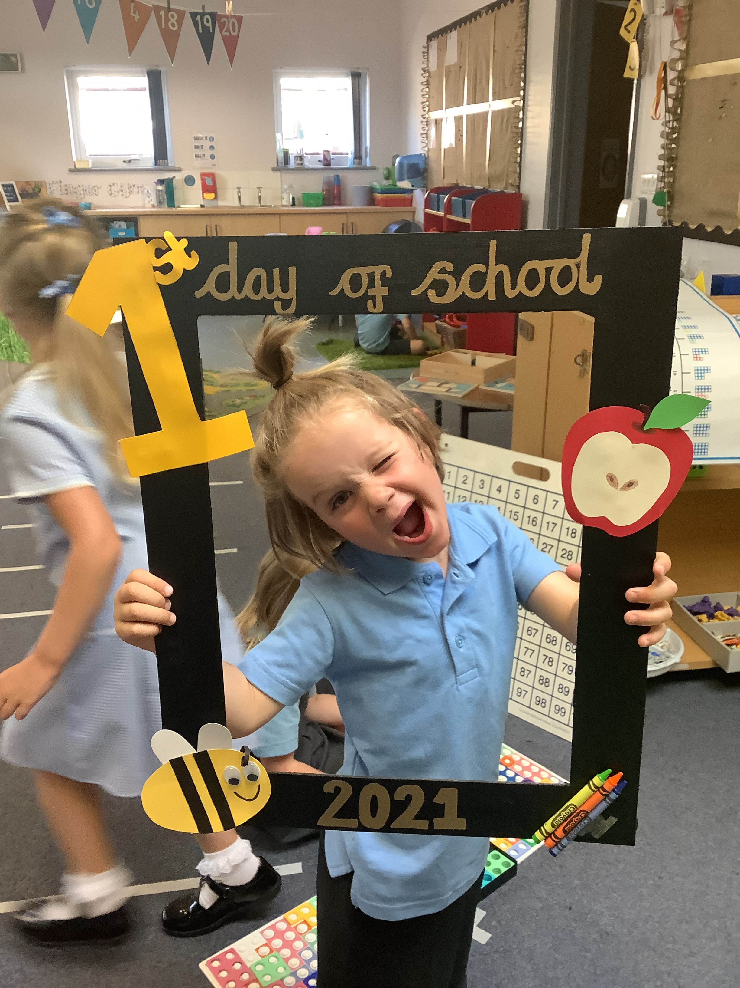
Welcome to Reception
Four principles of the EYFS
Unique child
Positive relationships
Enabling environment
Learning and development
Notes:
Natalie

Slide 3
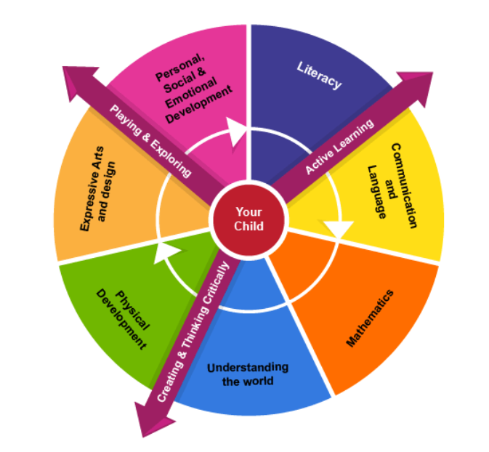
Foundation Stage Curriculum
Areas of Learning
3 Prime areas
4 specific areas
Characteristics of Learning
Our curriculum develops knowledge,
skills, motivations and attitudes
towards learning.
Notes:
Natalie

Slide 4
Tutshill Vision and Values
Love One Another, Know Ourselves, Believe and Grow
Forgiveness, Compassion
Respect, Responsibility
Creativity, Perseverance, Courage
Key Learning Behaviours
Know ourselves- Reflective, Evaluative, Cooperative
Believe and grow- Resilient, Resourceful, Risk taking, Curious
Notes:
Lori

Slide 5
Induction Programme Summer term 2024
Garden Visits- booking online. 11/12 June
Stay and Play sessions two dates 18/19 June 3.15-4.15pm
Two half day induction sessions. 25/26 June 1 morning 1 afternoon slot
Requirement to see birth certificate.
Children’s booklet
Half day Induction
Surname | Stay and Play 25/06/2024 | Stay and Play 26/06/2024 | September Induction group
A-M | 9.30-11.30 am | 1.00-3.00pm | A
P-Z | 1.00-3.00pm | 9.30-11.30 am | B
Notes:
Natalie

Slide 6
Induction Programme
September 2024
Monday 2nd September Inset day- no pupils on site.
Week1 02/09/24 | Group A | Mornings- Tues-Friday | Gate opens at 8.40am | Collect 11.45 playground
 | Group B | Afternoon Tuesday Wednesday-Friday ( with lunch | Arrive 1.00pm School Office. Arrive 12.10pm School Office | Collect 3.10. playground
Week 2 09/09/24 | Group B | Mornings | Gate opens at 8.40am | Collect 11.45 playground
 | Group A | Afternoon Monday Wednesday-Friday with lunch | Arrive 1.00pm School Office. Arrive 12.10pm School Office | Collect 3.10. playground
Week 3 16/09/24 | All | Monday- Friday Full Time | Gates open 8.40am | Collect 3.15 playground
Notes:
Natalie

Slide 7
Required forms
Cool Milk- please sign up but don’t purchase after 5th birthday.
Pupil information form and data collection form
Parental consent form
Tapestry data sharing consent form
E- safety policy acceptable use agreement
Home- school agreement
Teddy form- child’s voice.
Notes:
Natalie

Slide 8
Preparing your child for school
Talk to them, listen to them.
Spend time together.
Share stories and nursery rhymes.
Teach them to dress and undress
Give them time away from you- develop their independence
Allow them to do things on their own- i.e. tidy up, make breakfast, lay the table, put their belongings away, carry their own belongings.
Notes:
Lori

Slide 9
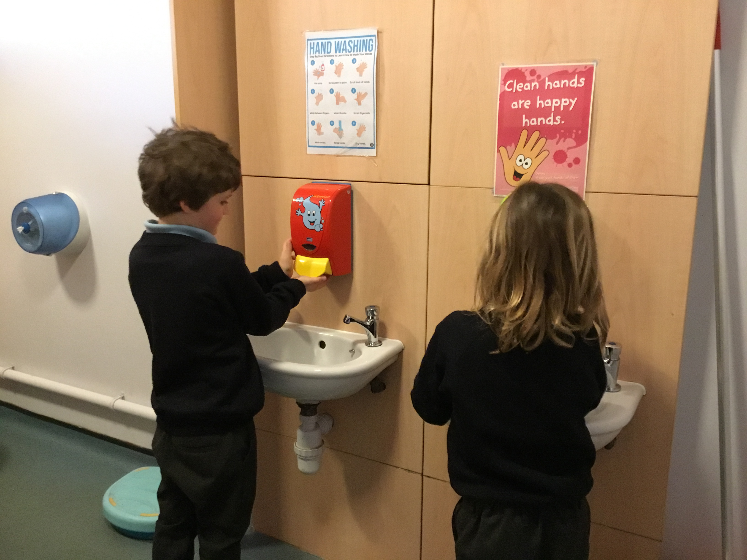
Preparing your child for school- Key skills
Go to the toilet and wash hands
Recognise their name
Eat food by themselves
Use a knife and fork
Drink from a cup
Get dressed and undressed- turn jumper arms right way out.
Put on and take off shoes
Hang up coat and Zip up coat
Recognise their name
Say please, thank you and excuse me
Please no Backpacks
Notes:
Lori

Slide 10
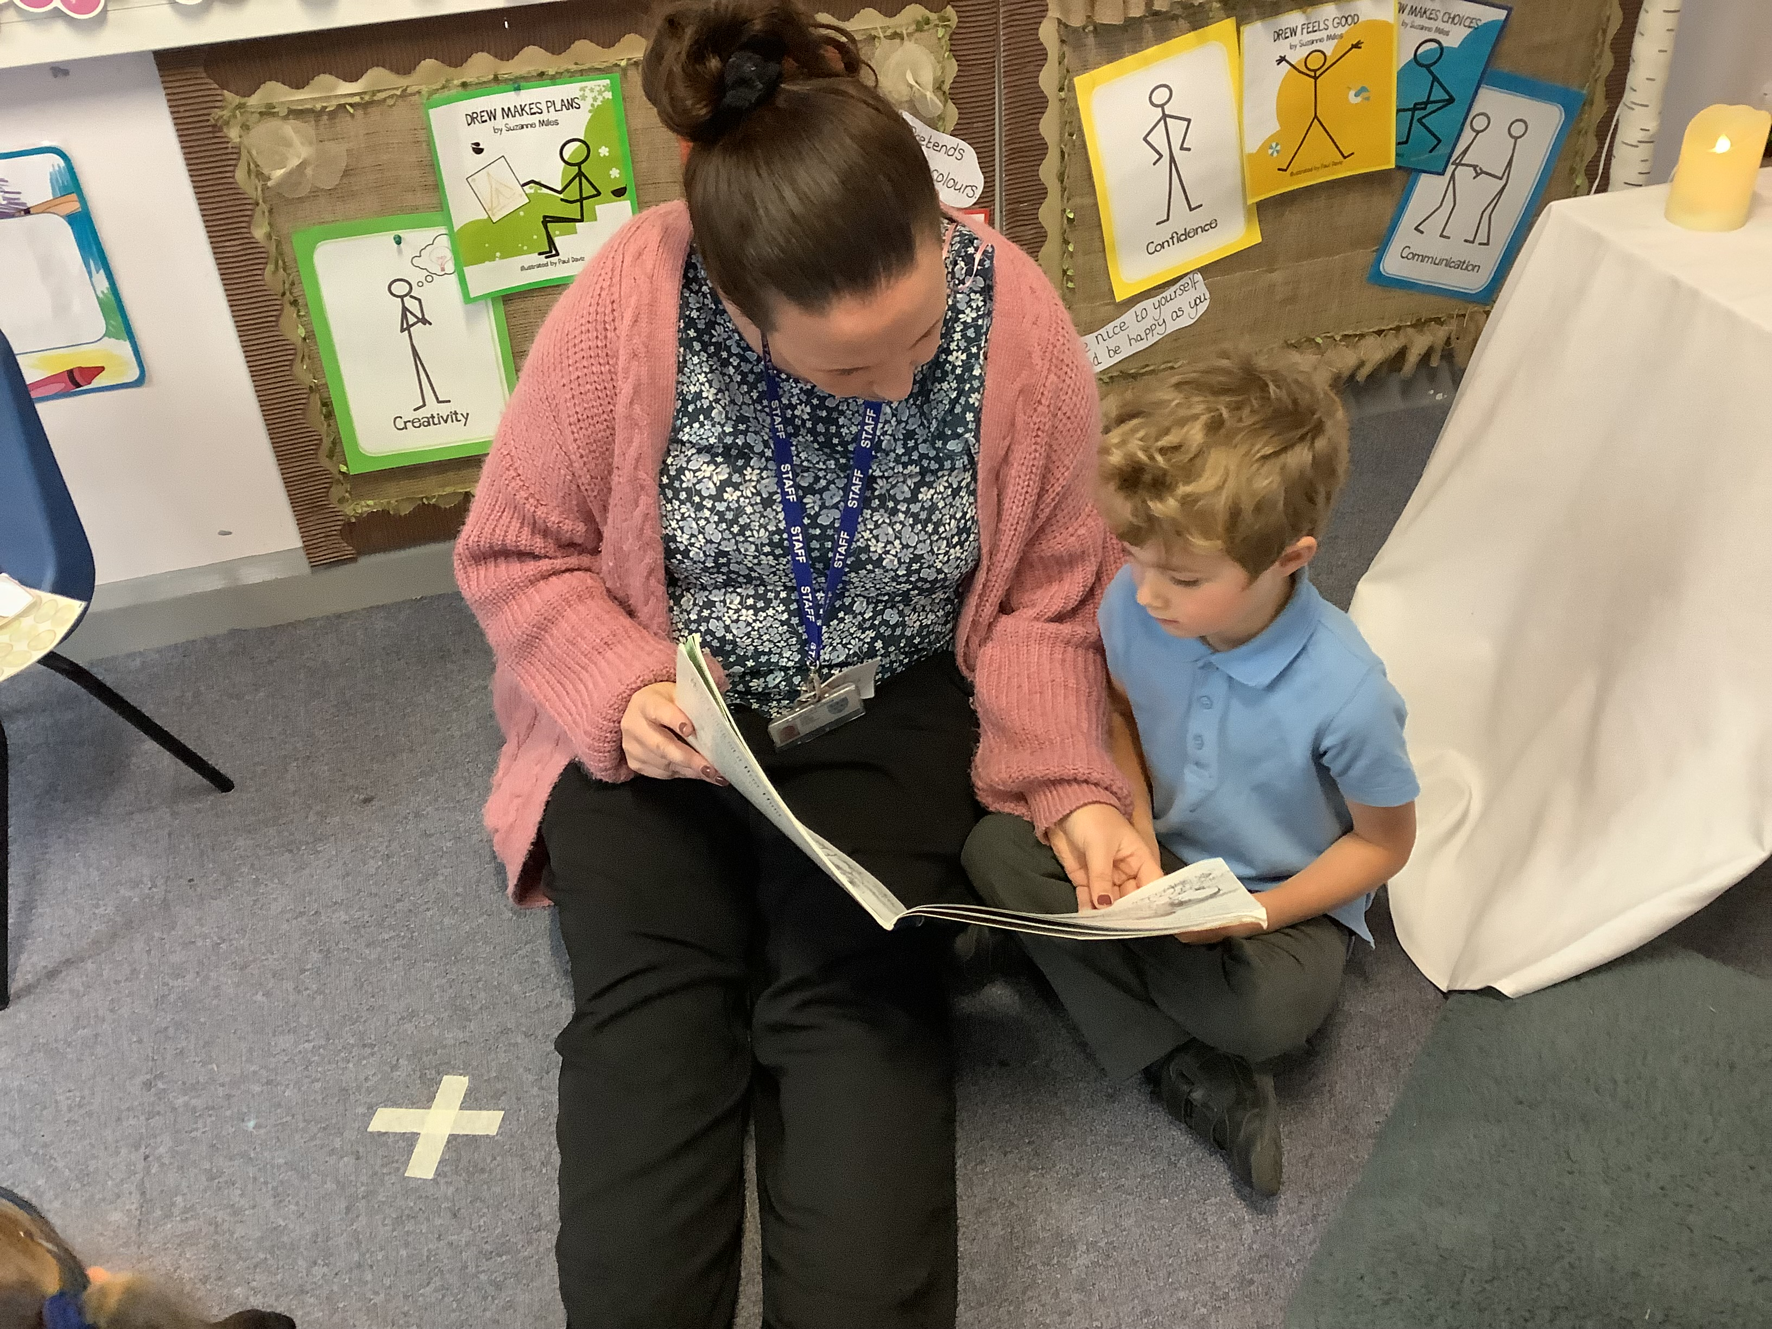
School day timings-
Gates open 8.40 school starts 8.45-3.15pm
A typical day involves time spent choosing activities and following own interests and working with adults.
Mornings -emphasis on phonics reading and especially early reading and reading for pleasure.
Teacher guided, play based tasks.
Teacher led sessions- phonics, maths, writing,
Notes:
Natalie

Slide 11
Baseline Assessment
Government Baseline. Maths, Reading
School Baseline
Observational assessment collected through talking, playing and interacting with the children.
.
Notes:
Natalie

Slide 12
Tapestry
Online Learning Journal.
Please contribute. It is your child’s learning journal- not just about school.
Upload photographs, observations, comments

Slide 13
Questions?

