Slide 1
Welcome
N
Reception 2023

Slide 2
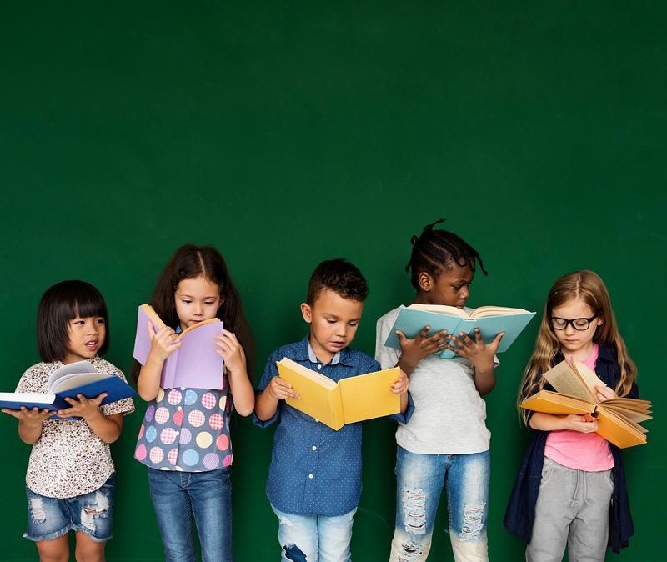
Reading for Pleasure, Reading for Learning.
N
Reading in reception has two distinct parts and how we read is different depending on what type of reading we are doing.
Reading for pleasure is the most important part- we want reading to be fun.
Reading for learning is so important, because in order for children to start to independently read for pleasure we need to teach them how to do it.
This Photo by Unknown Author is licensed under CC BY-ND

Slide 3
Reading- Rising Stars Phonics
L
Reading is about making sense of words, by looking at written symbols and making meaning from them.
Schools have to teach reading using a synthetic phonics approach- where words are broken up into the smallest units of sound and blend them together to read, or hear each unit of sound to write
Tricky words and phonic sounds.
Letters are introduced at a steady pace- 2 a week.
Consistent daily practice.
The aim is for all children to keep up with the process.
There will be a difference in approach from previous years.

Slide 4
Reading- making meaning from marks
L
You are trying to read this and it probably doesn’t make much sense to you. That is because you don’t have the skills it takes to read it. You will need to learn what each of the letter shapes mean and how they go together to make words. Some of the words won’t even sound like the letters that are in them.
Teaching order of the graphemes. Phonemes and digraphs
s, a, t, I, p, n, m, d, g, o, c, k,
ck, e, u, r, h, b, f, ff, l, ll, ss
J, v, w, x, y, z, zz, qu
ch, sh, th, ng, ai, ee, igh, oa, oo,
ar, or, ur, ow, oi, ear, air, ure, er

Slide 5
Reading- making meaning from marks
N
Blending is the process of running sounds together to make words for reading
Oral blending- can be done at any time, get your b.a.g. put on your h.a.t.
Modelled blending – pointing to each of the graphemes in a word, saying the sound, then running your finger underneath the whole word and saying the word out loud.
b a g h a t
Supported blending adult points to the graphemes in each word whilst child says them, then runs finger under the whole word to make the word
Independent blending- this starts out loud and then the child may sound out in their head as they read
Fluency- This is something we are aiming for, but continuing to use sounding out is important so that words are not guessed.

Slide 6
Reading- making meaning from marks
N
For some words the phonetic system does not work so we teach the concept of Tricky Words. Tricky words are learned by sight.
We draw attention to the ‘tricky’ parts of the word
Tricky words and phonic sounds.
The first sets of words are :-
1) to go no I the
2) me he we be she
are you they her, said, have, like, so do, some, come, little, one, were, out, what, when, where

Slide 7
Reading for Pleasure
L
Phonics gives children the tools to read, but listening to stories and seeing their role models read and view reading as important will inspire them to read.
Reading for pleasure is the time you snuggle up, read stories in bed, look at pictures, predict what is happening, what might happen.
Reading for pleasure is about having a favourite story over and over until it can be memorised and the book falls apart.
Library books chosen by children. They can read what interests them
The single most important thing you can do for your children is to read to them-. Keep reading to them long after they can read themselves.
The relationship you build while reading to them will give them that desire, empathy and understanding of reading. You are tuned into body language, can discuss events, experiences and make plans based on the reading.
Let them see you reading- let them see a house with words- books, magazines, recipes, newspapers,- leave them around, open, look at them together,
Show them you value reading,

Slide 8
Reading for Learning
L
How you support your children with the process of learning to read.
More formal approach,
Not a bedtime reading routine or as appropriate for snuggling.
Ipad and technology very appropriate for this type of learning

Slide 9
Reading at home
L
Reading for Pleasure | Reading for Learning
Repetition, Repetition, Repetition School Library books. Read to children, read with expression and enjoyment. Go to the library or bookshop- make the choice of book fun. Children can spot words or letters they may know- but don’t make it a chore. Read a book so many times that the children can read it themselves from memory Spot the funny parts in the pictures Have fun! | Repetition, Repetition, Repetition. Practise the Tricky words Practise the sounds in the sound book- even when they are known Practise the ‘I can blend sheets’ Spot letters and words around the house/ outside/in Tesco. Use online scheme- books matched to correct level. Progressive Rewarding quizzes Short bursts- but not at bedtime.

Slide 10
Literacy in school
N
Daily reading time.
Phonics, tricky words, word building, opportunity to learn around and about stories and rhymes.
Phonics sessions
Daily session with learning sounds, learning how to identify sounds in words and use sounds to read and write words.
Daily physical development opportunities for handwriting-
Playdough, finger gym, gross motor skills, handwriting practise, name writing
Adult directed writing tasks
Incidental moments in the day to practise, refine and rehearse.
Reading stories and time to explore books- often.
Repetition, Repetition, Repetition.

Slide 11
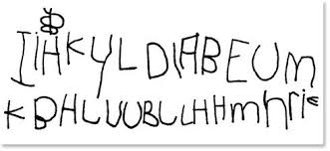
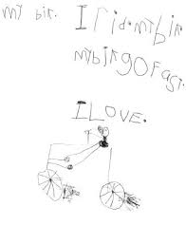
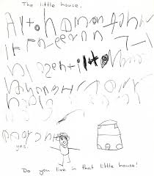
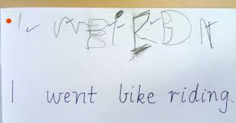
Emergent writing
N

Slide 12
Segmenting- for writing
N
Segmenting is the process of identifying individual sounds in words
Modelled oral segmenting – saying the word, robot speaking the word and counting the sounds that can be heard using their left hand.
r ai n
Modelled segmenting robot speak the word, count the sounds and write each letter shape on a sound button
__ ___ ___ ___ R ai n
Independent segmenting- Using dictated words, children identify the sounds, count how many are needs and write the corresponding letter shapes.
Independent writing.
.

Slide 13
Pencil grip

