Slide 1


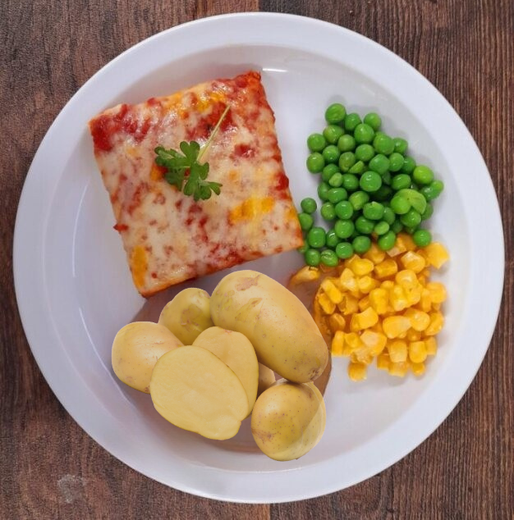

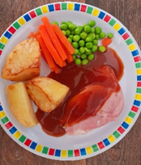
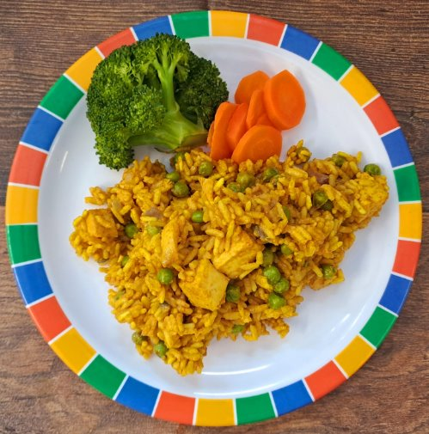
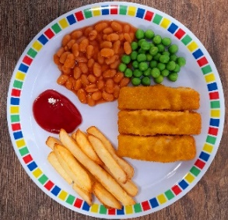
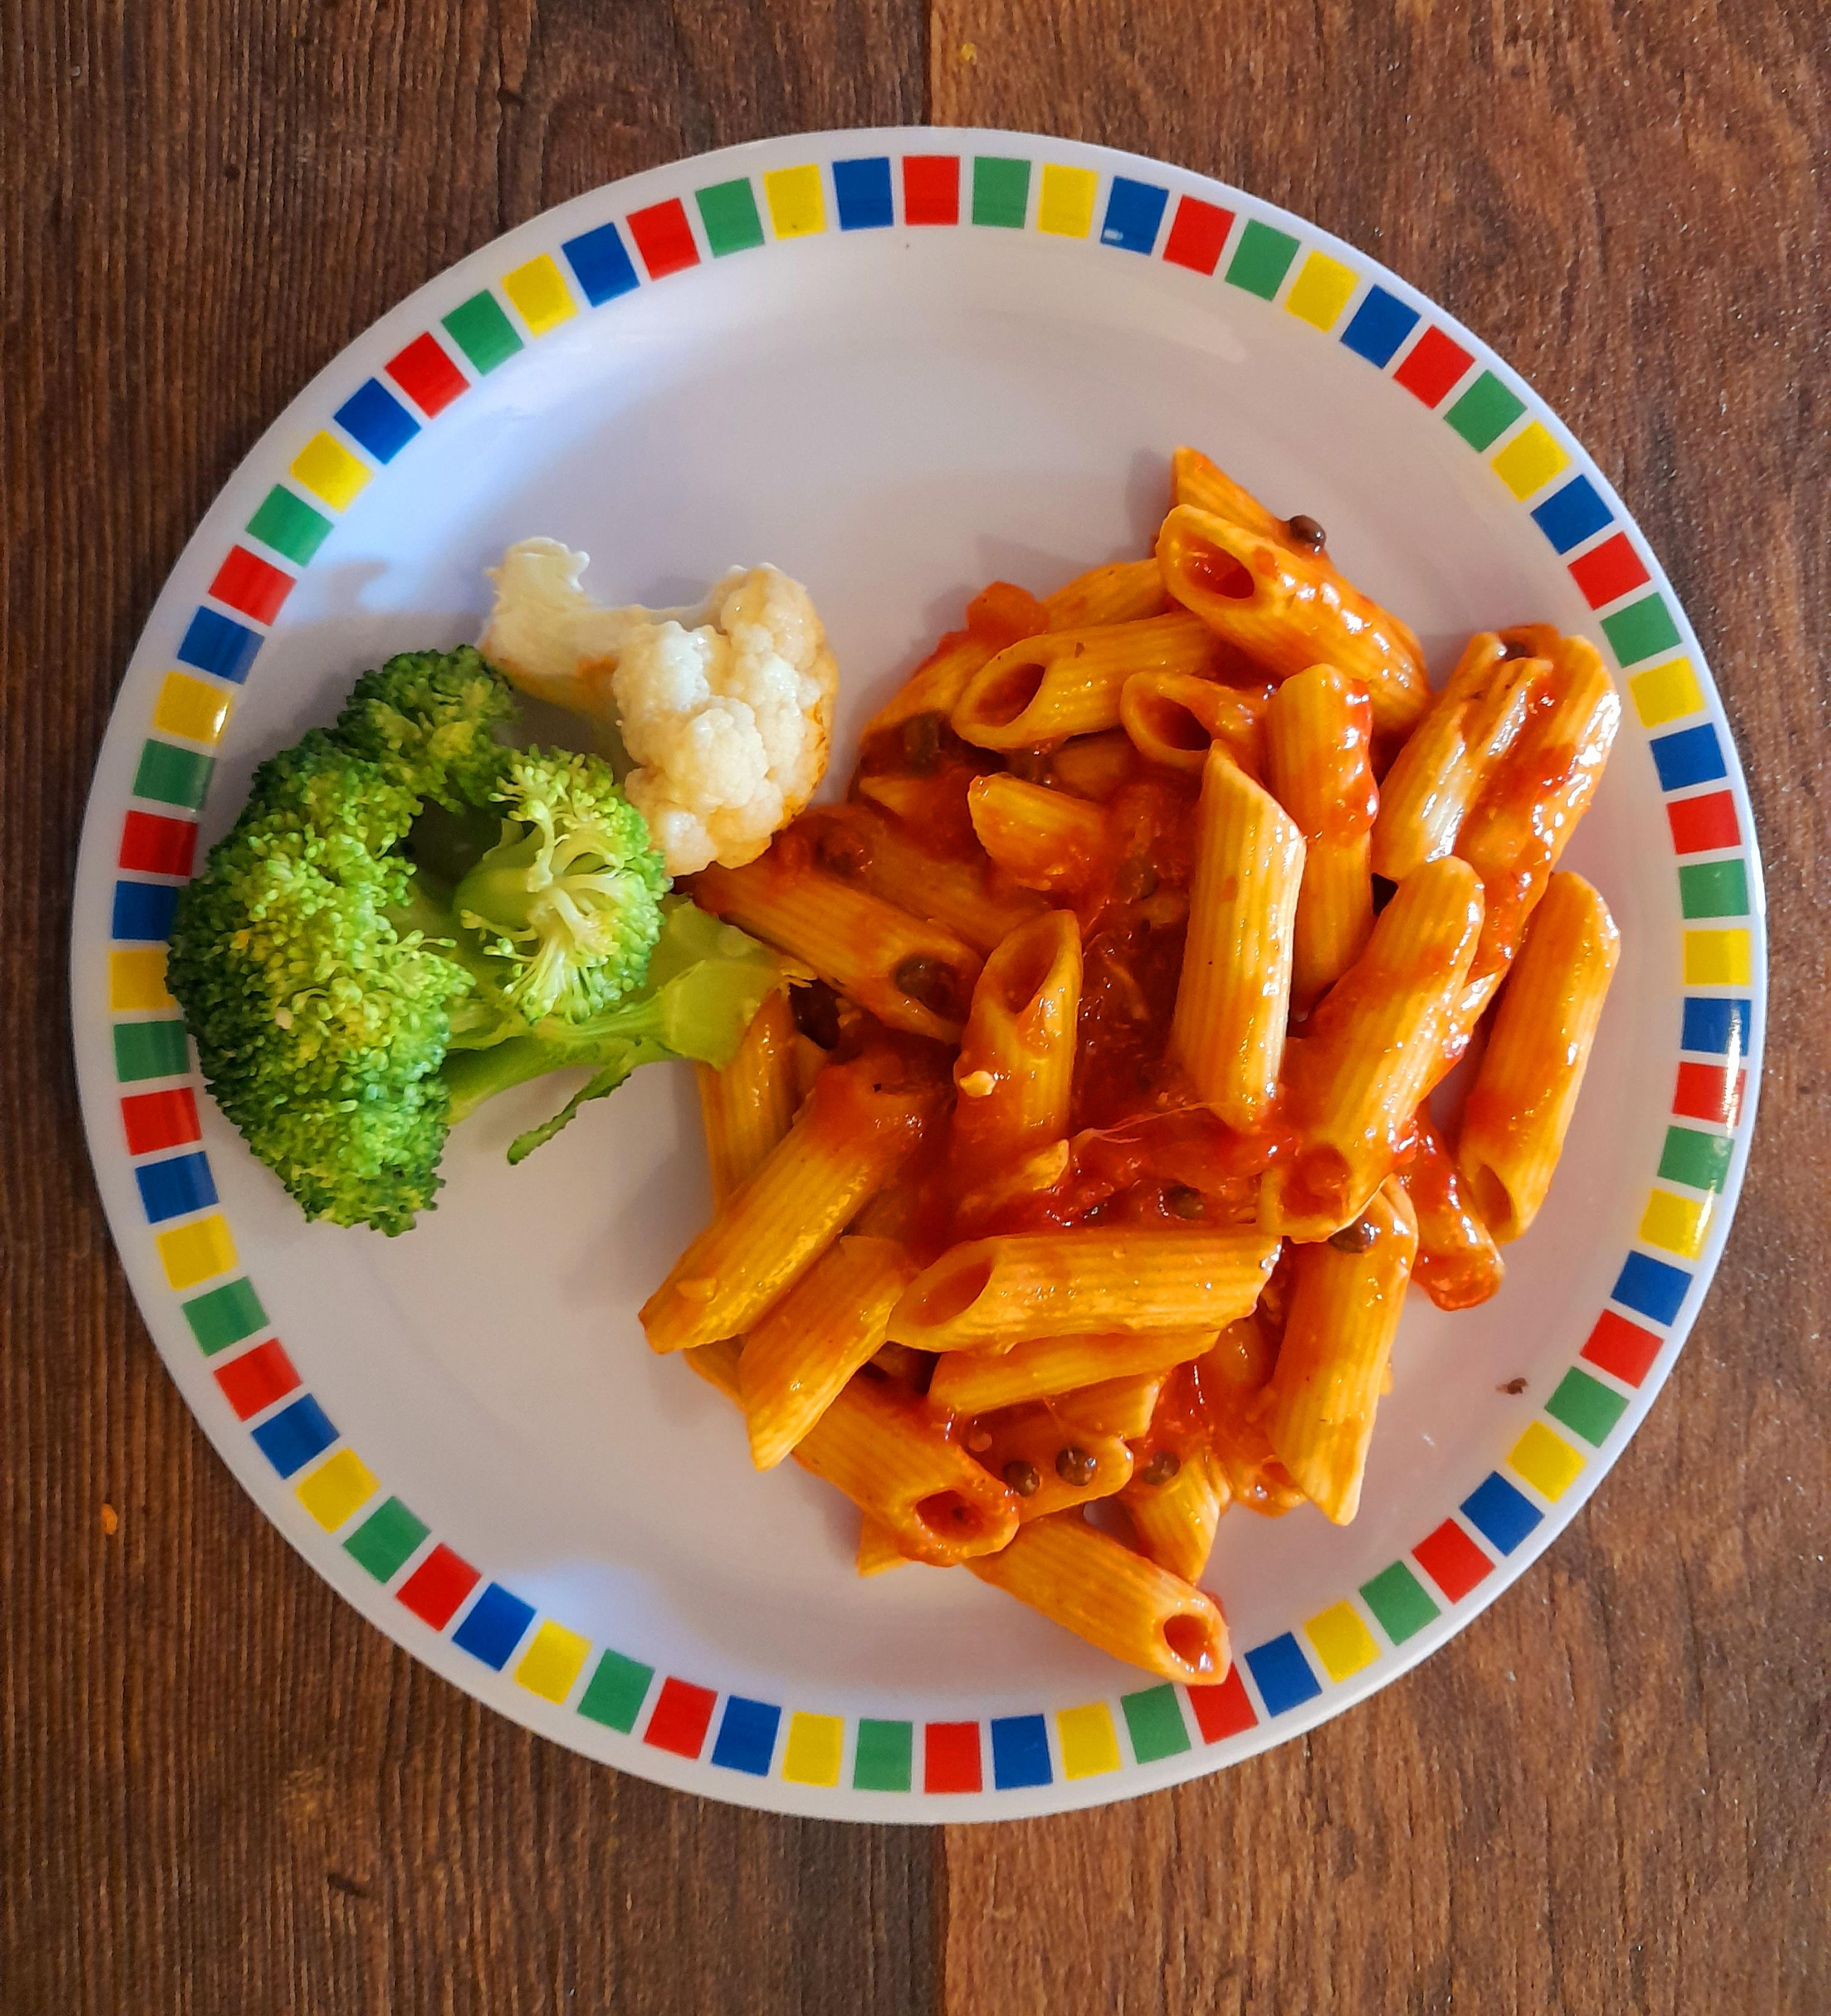
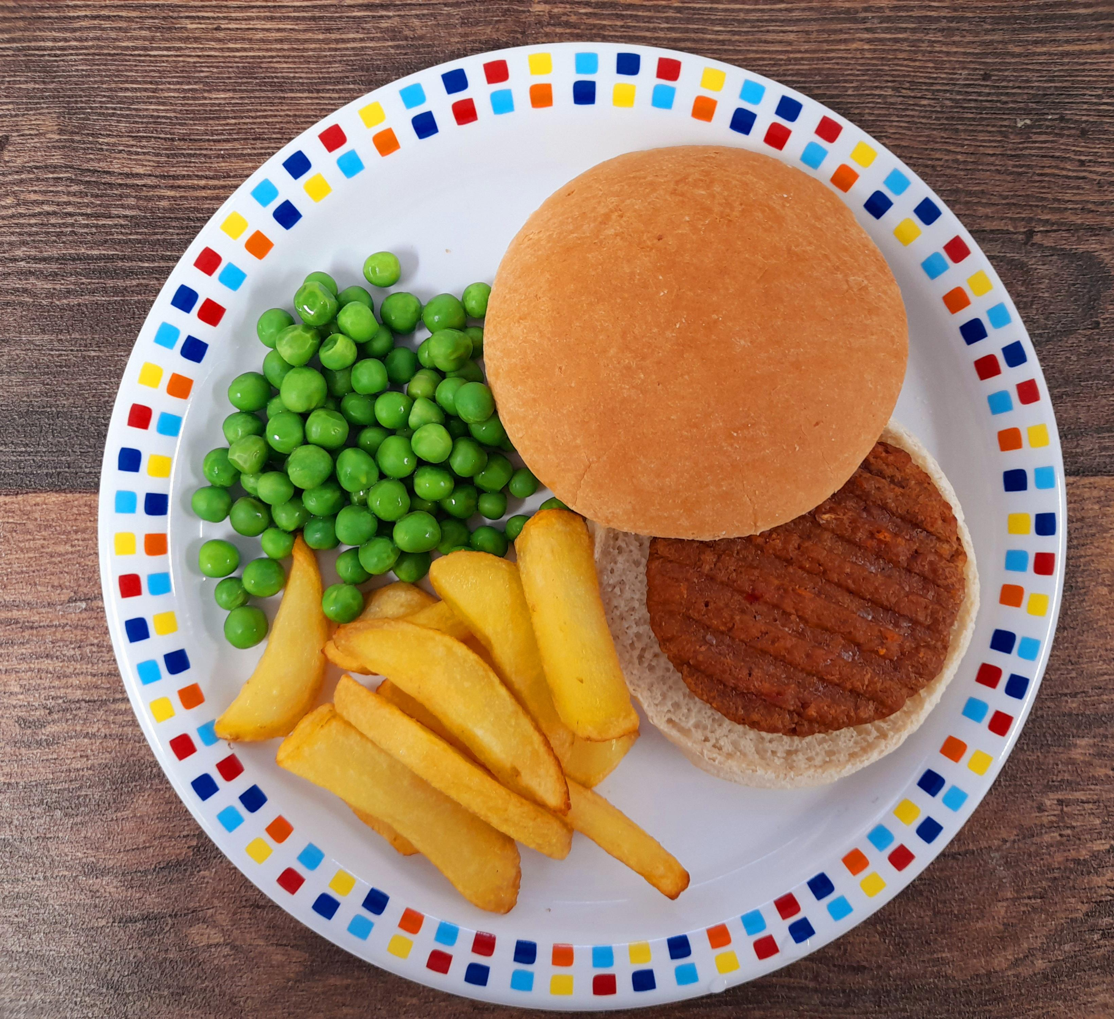

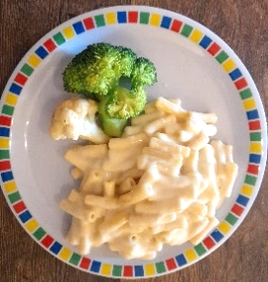
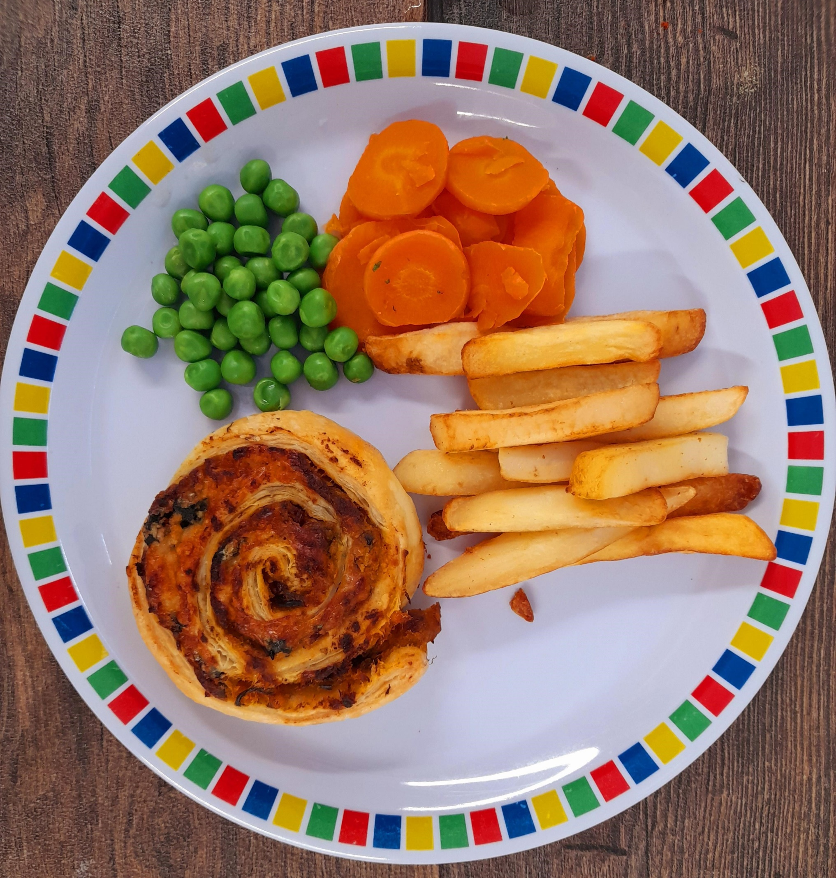
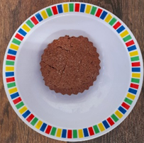
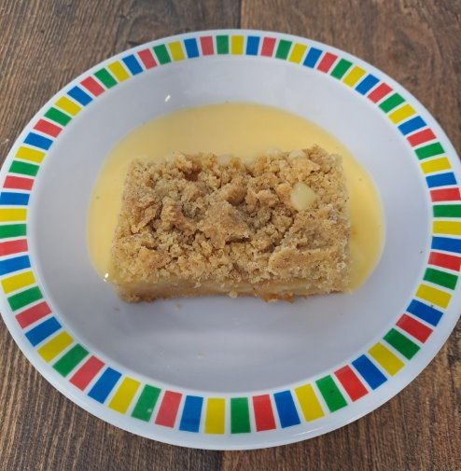


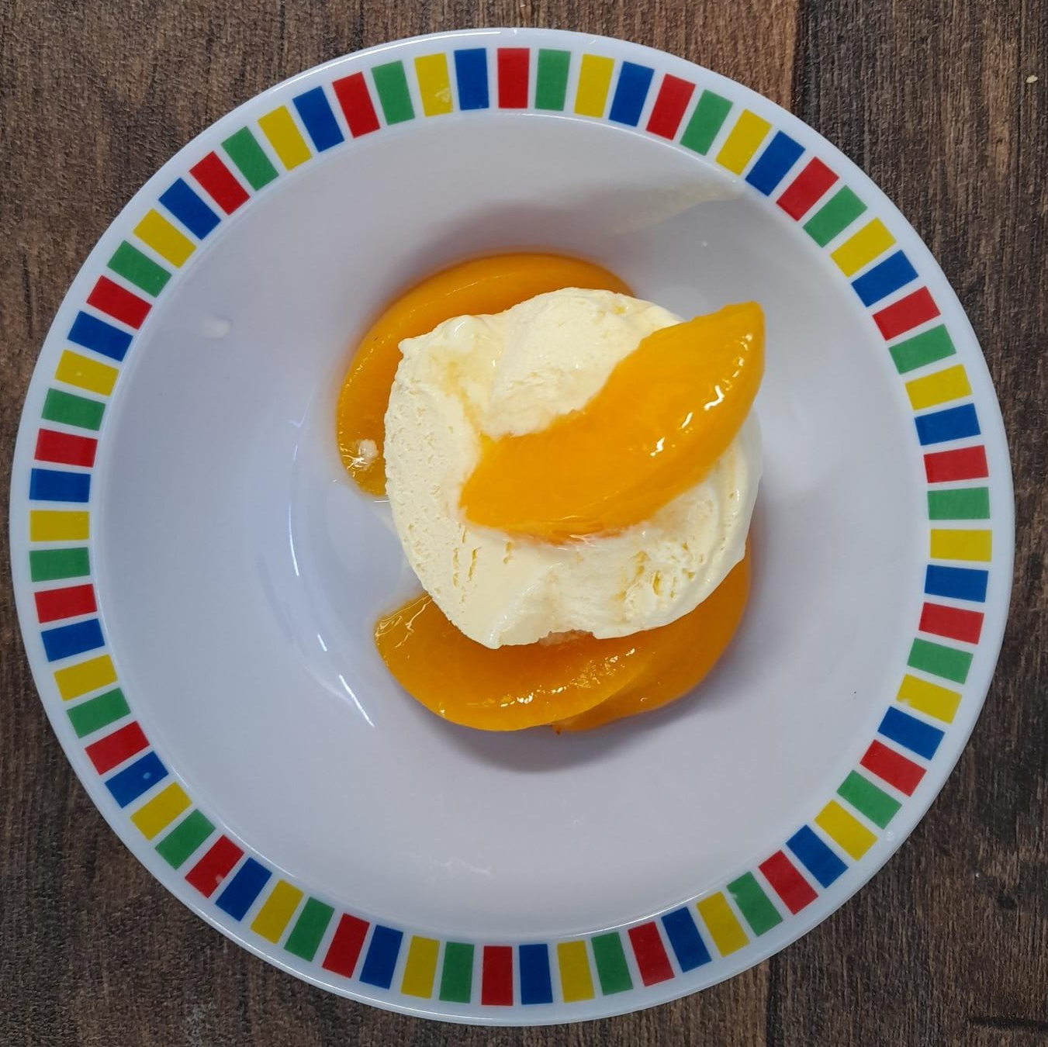

Autumn Winter 2025 2026
Classic Cheese and Tomato Pizza with New Potatoes | Beef Meatballs in Tomato Sauce with Rice | Roast Gammon with Roast Potatoes and Gravy | NEW Curried Chicken and Rice | Fish Fingers with Chips & Tomato Ketchup
Vegetable Pasta bake | Vegan Burger in a Bun with Potato Wedges and Tomato Ketchup | Roast Quorn Fillet with Roast Potatoes and Gravy | Macaroni Cheese | Cheese Whirl with Chips and Tomato Ketchup
Chocolate Shortbread | NEW Apple Crumble Cake with Custard | Cinnamon Swirl with Fresh Fruit | Syrup Sponge with Custard | Ice Cream and Peaches

Slide 2
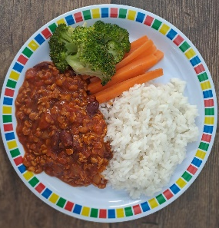
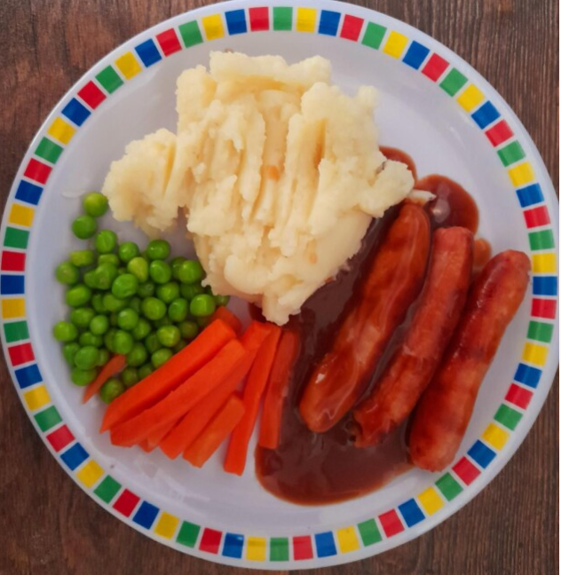
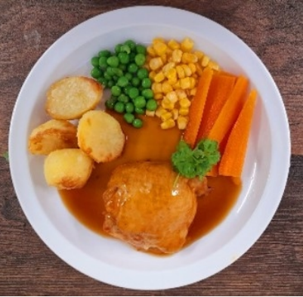
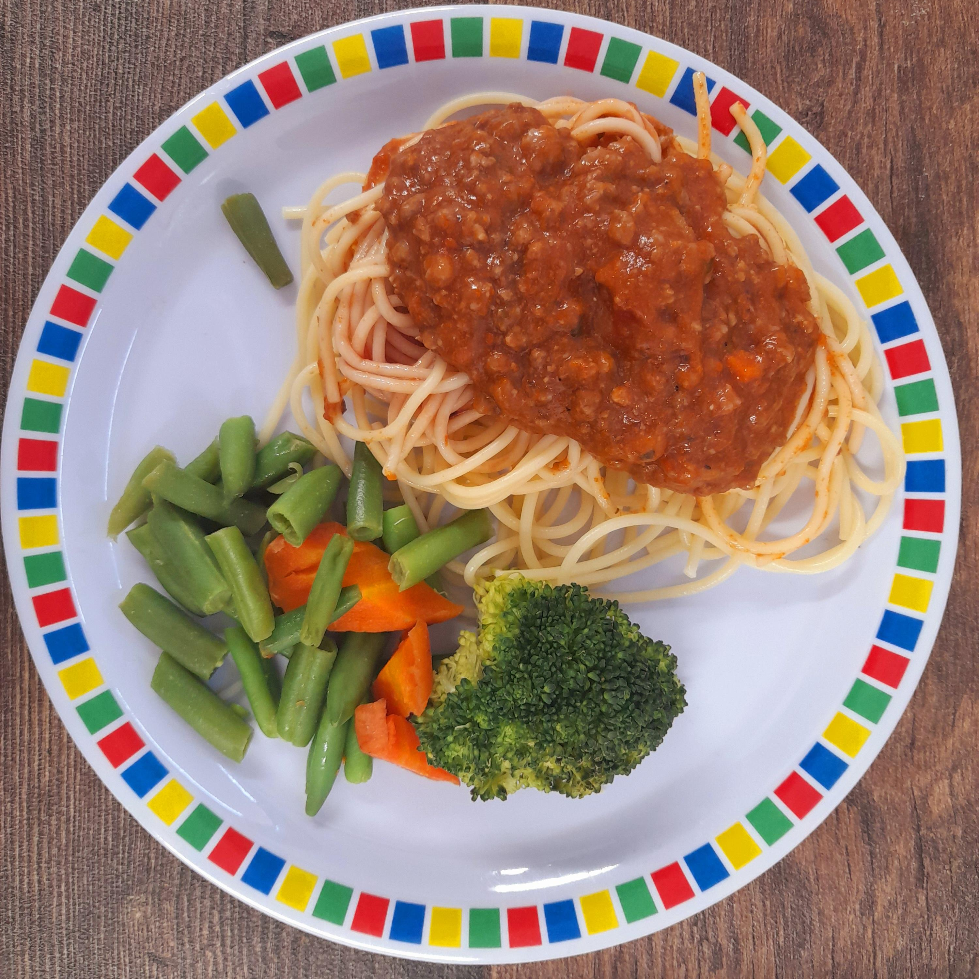

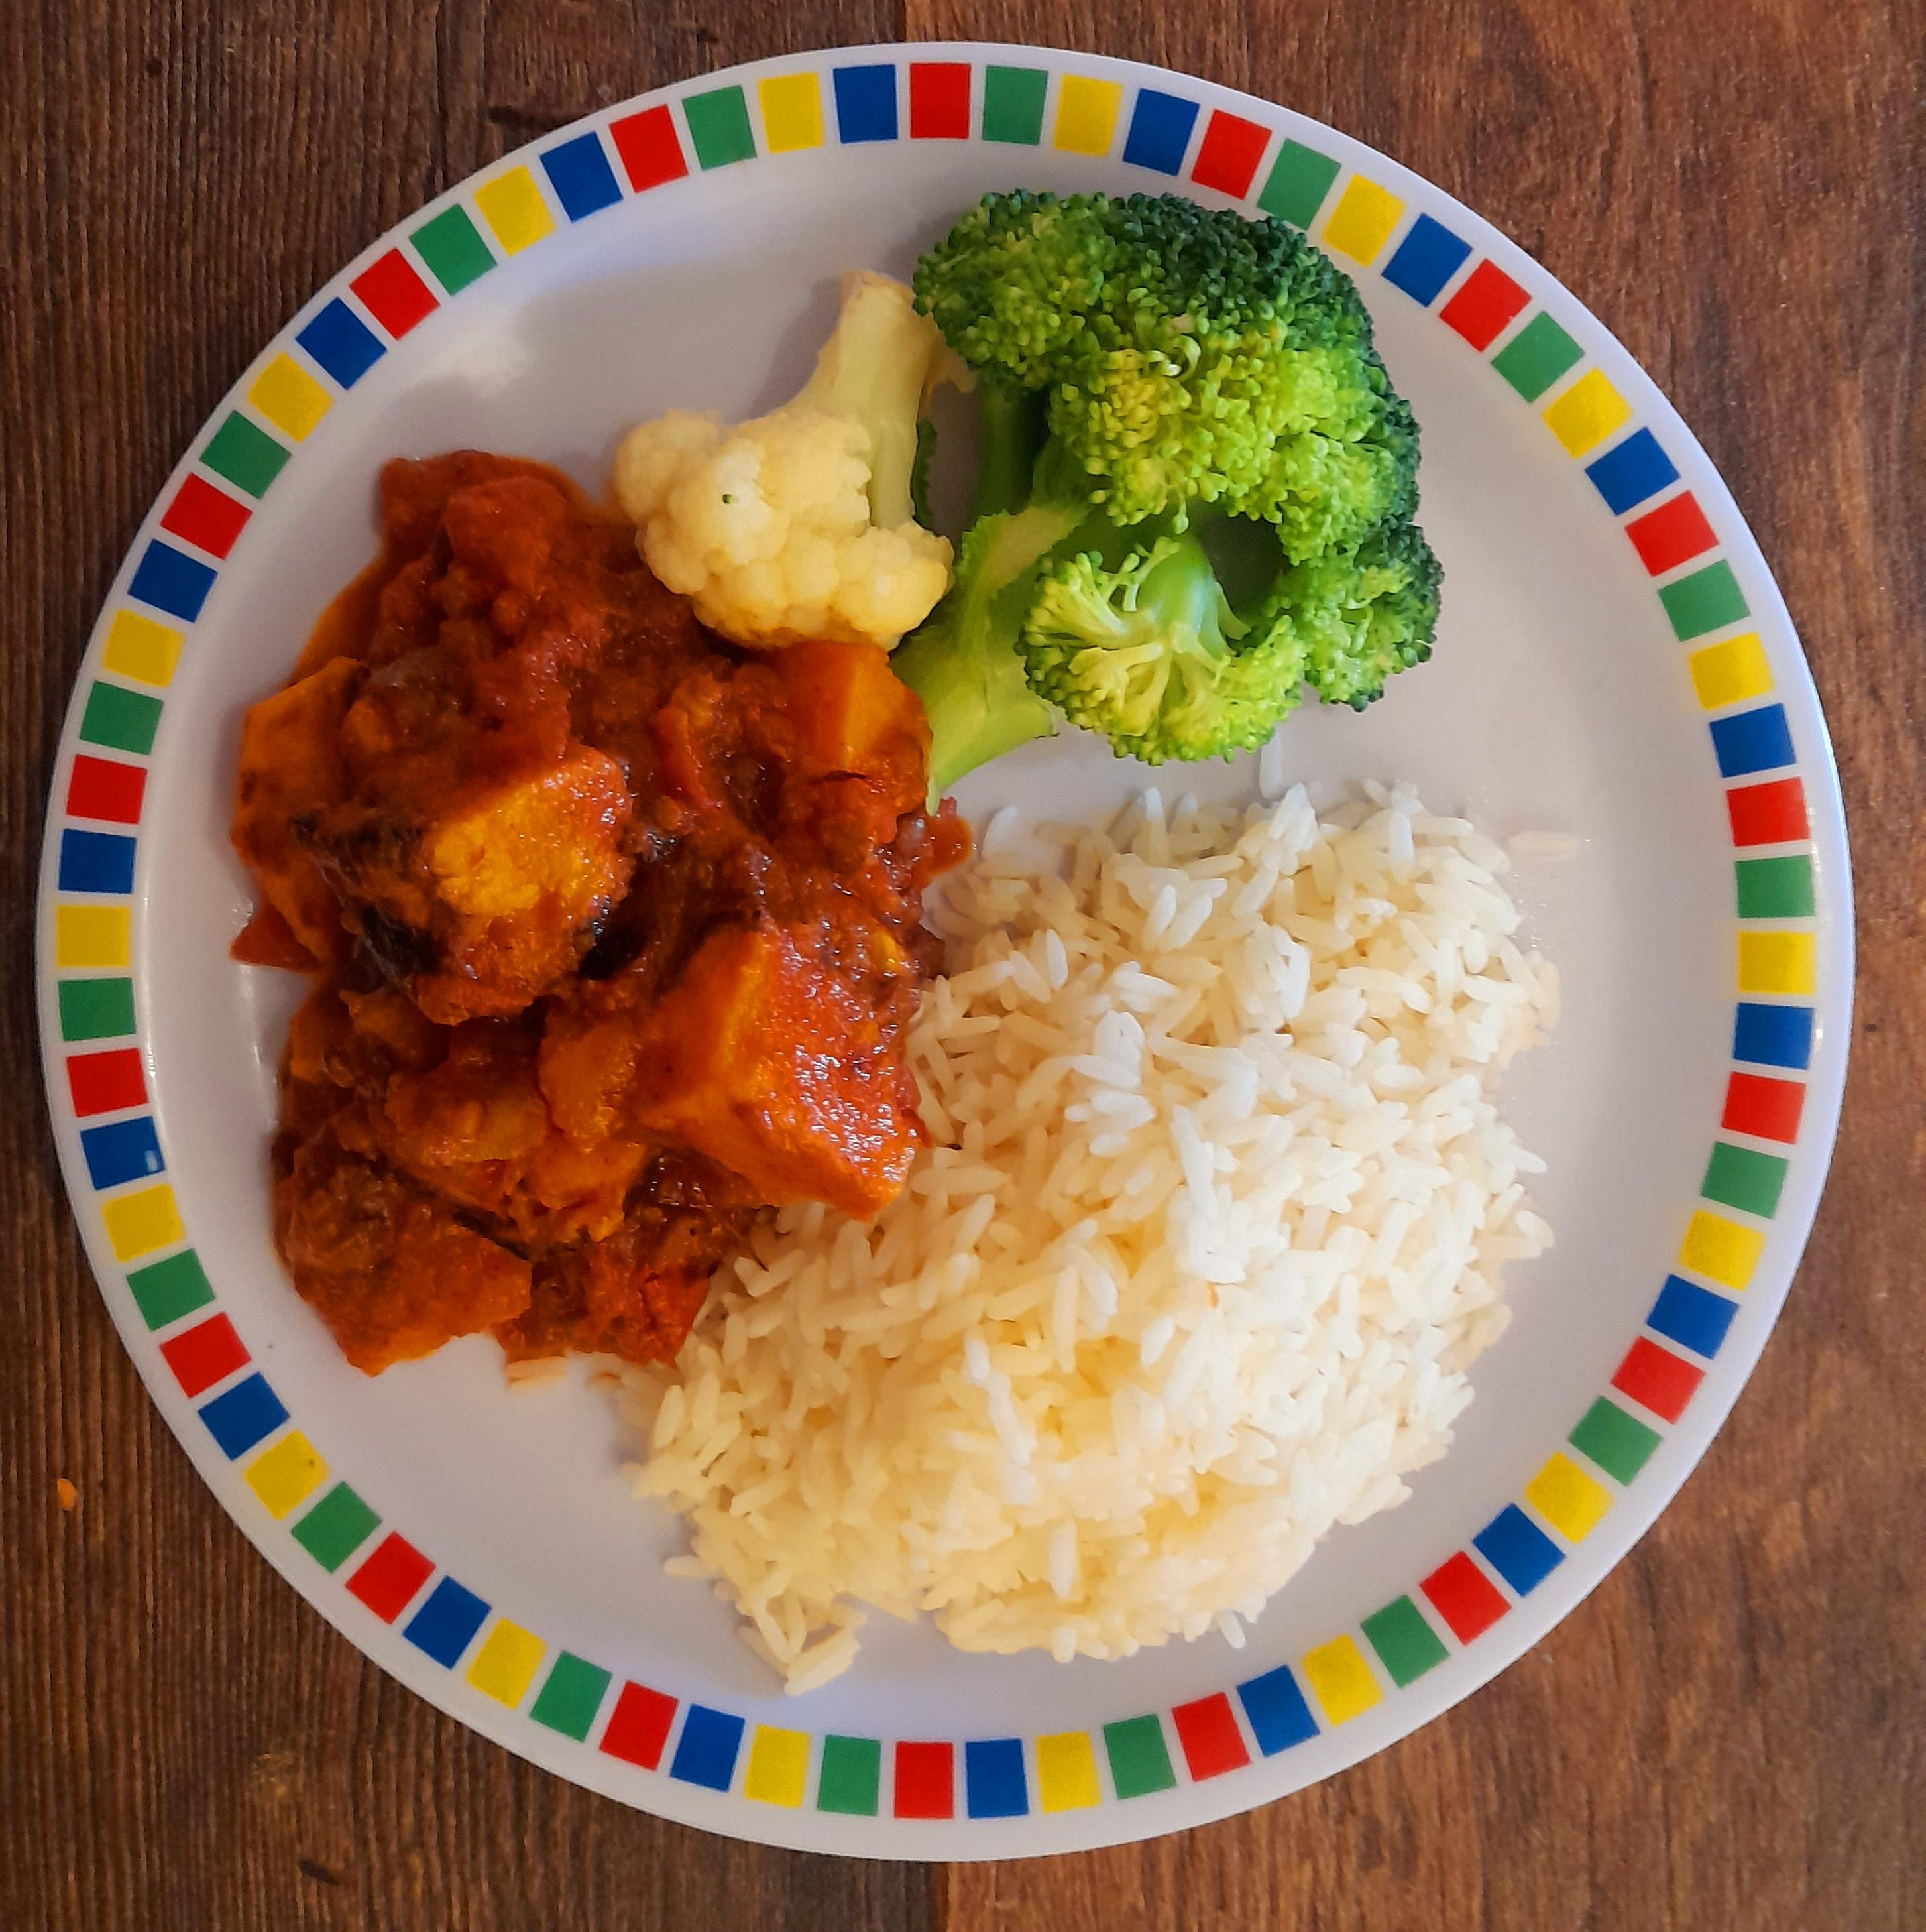
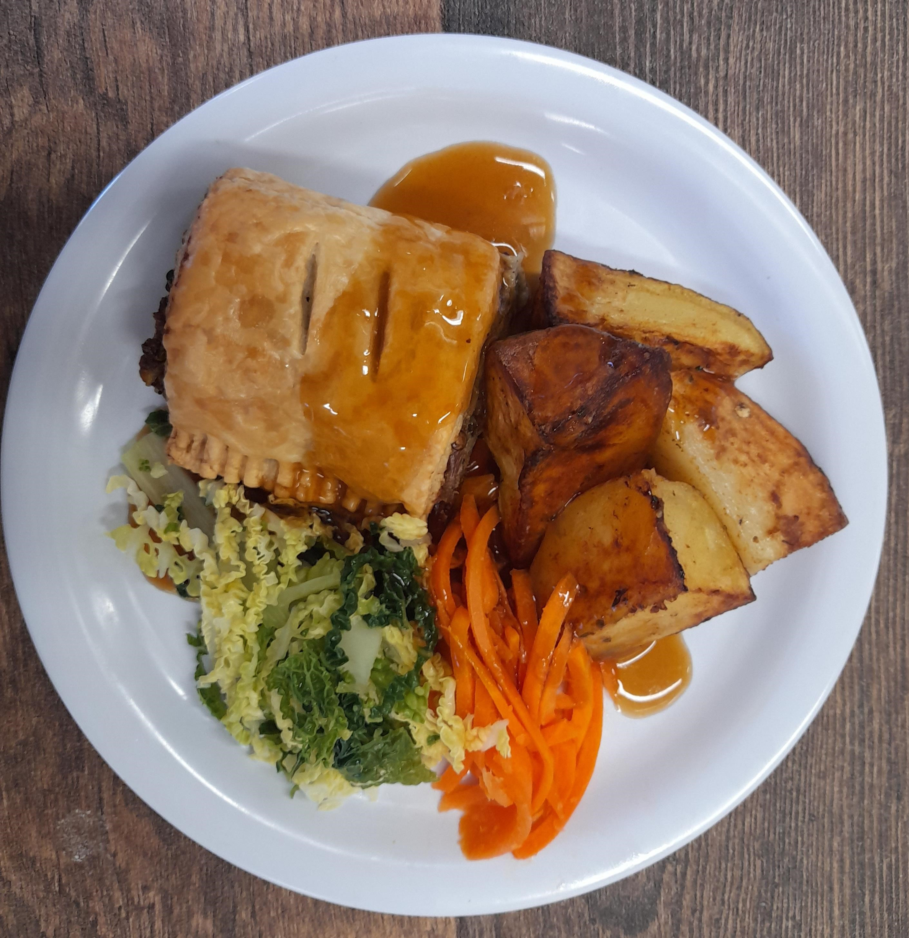
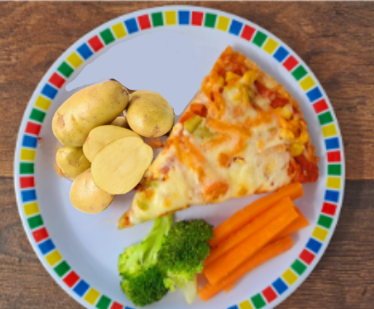

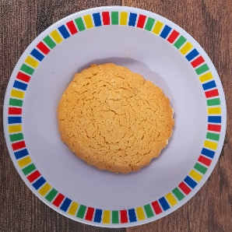
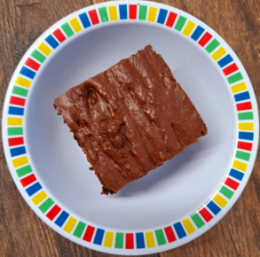
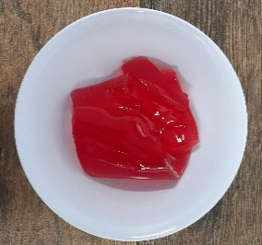
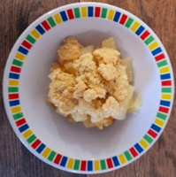
Autumn Winter 2025 2026
Mild Mexican Chilli with Rice | Sausage and Mash with Gravy | Roast Chicken with Stuffing, Roast Potatoes and Gravy | Spaghetti Bolognaise with Garlic Bread | Fish Fingers with Chips & Tomato Ketchup
Vegan Meatballs in Tomato Sauce with Spaghetti | NEW Chefs Special Lentil Curry with Rice | Vegetable Wellington with Roast Potatoes and Gravy | Roasted Vegetable Pizza with New Potatoes | Red Pepper Frittata with Chips & Tomato Ketchup
NEW Gingerbread Cookie | Chocolate Brownie with Chocolate Sauce | Strawberry Jelly with Peaches | Autumn Pear Crumble with Custard | Vanilla Shortbread

Slide 3
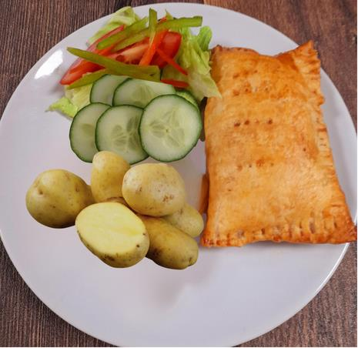
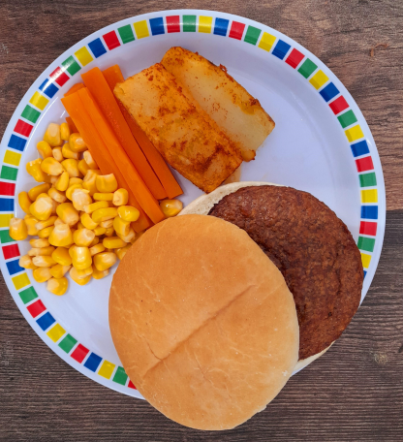


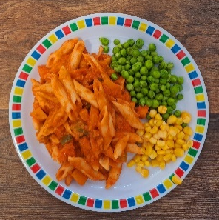
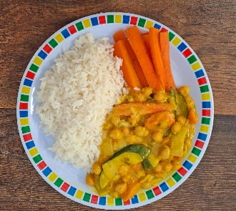
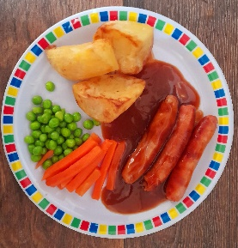
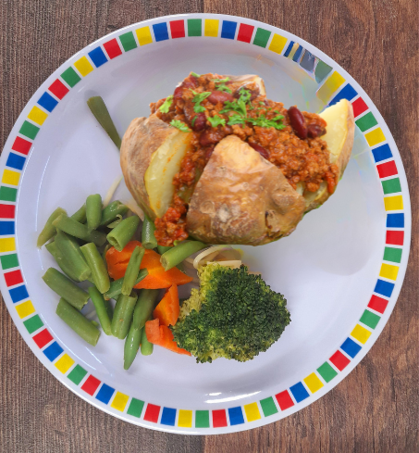



Autumn Winter 2025 2026
Cheese and Bean Pasty with New Potatoes | Beef burger with Cheese in a Bun with Wedges and Tomato Ketchup | Roast Chicken with Roast Potatoes and Gravy | NEW Chicken Enchilada Bake with Rice | Battered Fish with Chips & Tomato Ketchup
Tomato Pasta | Creamy Coconut Curry with Rice | Vegan Sausage with Roast Potatoes and Gravy | Jacket with Vegan Bolognaise | Mexican Bean Roll with Chips and Tomato Ketchup
Oaty Cookie | Eves Pudding with Custard | Ice Cream and Fresh Fruit | Jam and Coconut Sponge and Custard | Melting Moment Biscuit

