Slide 1
Welcome
Reception 2024; Natalie Fryer, Lori Pender, emma Spiller, Emma Tyldesley
NF

Slide 2
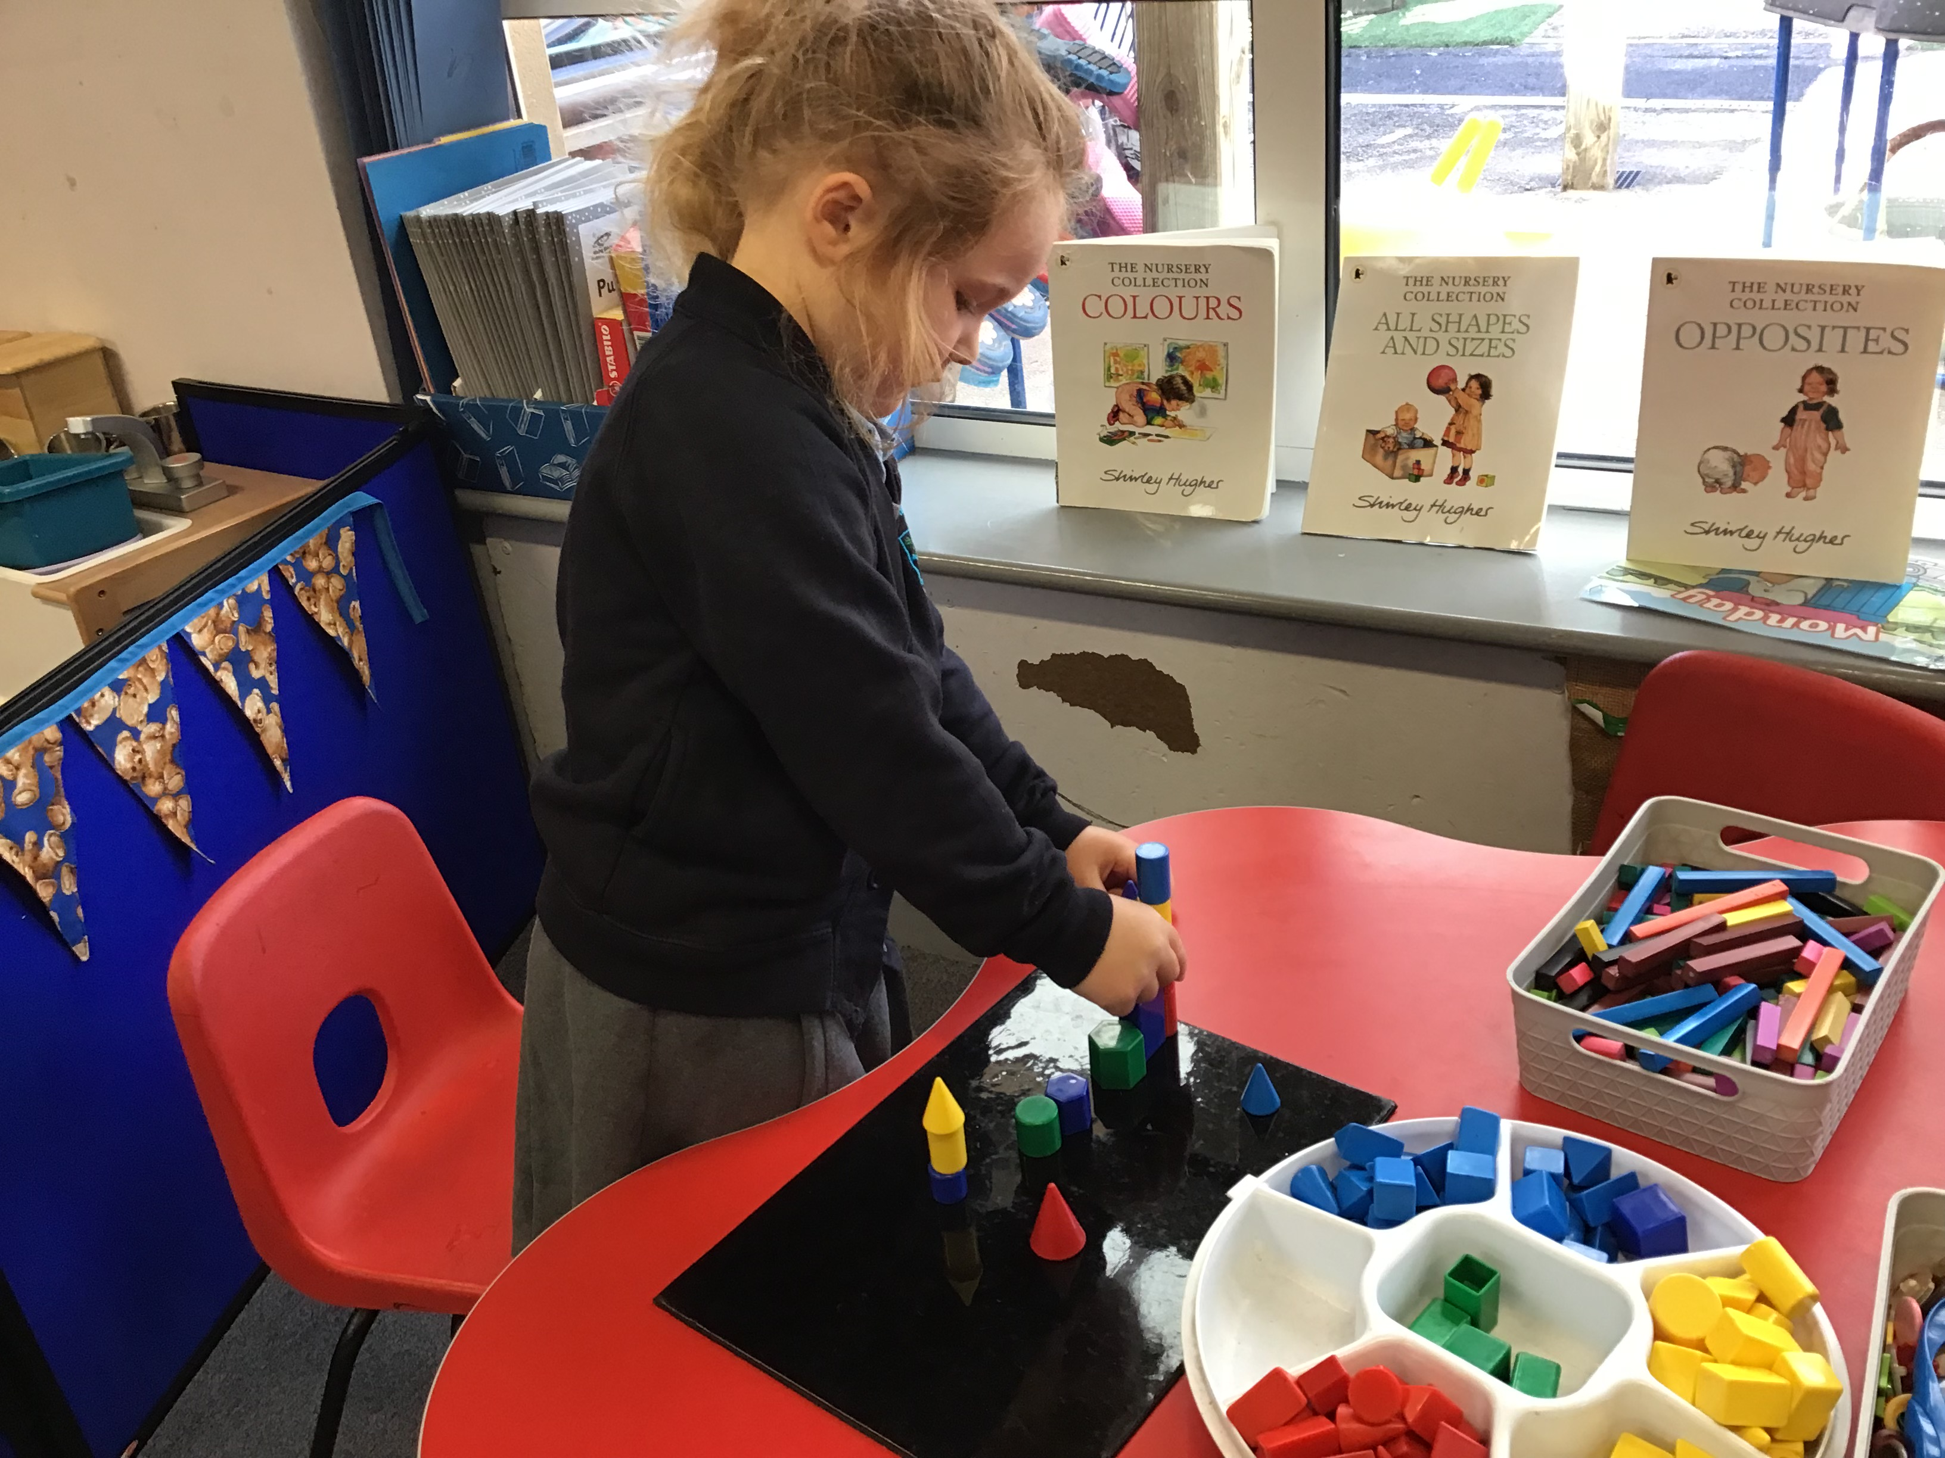
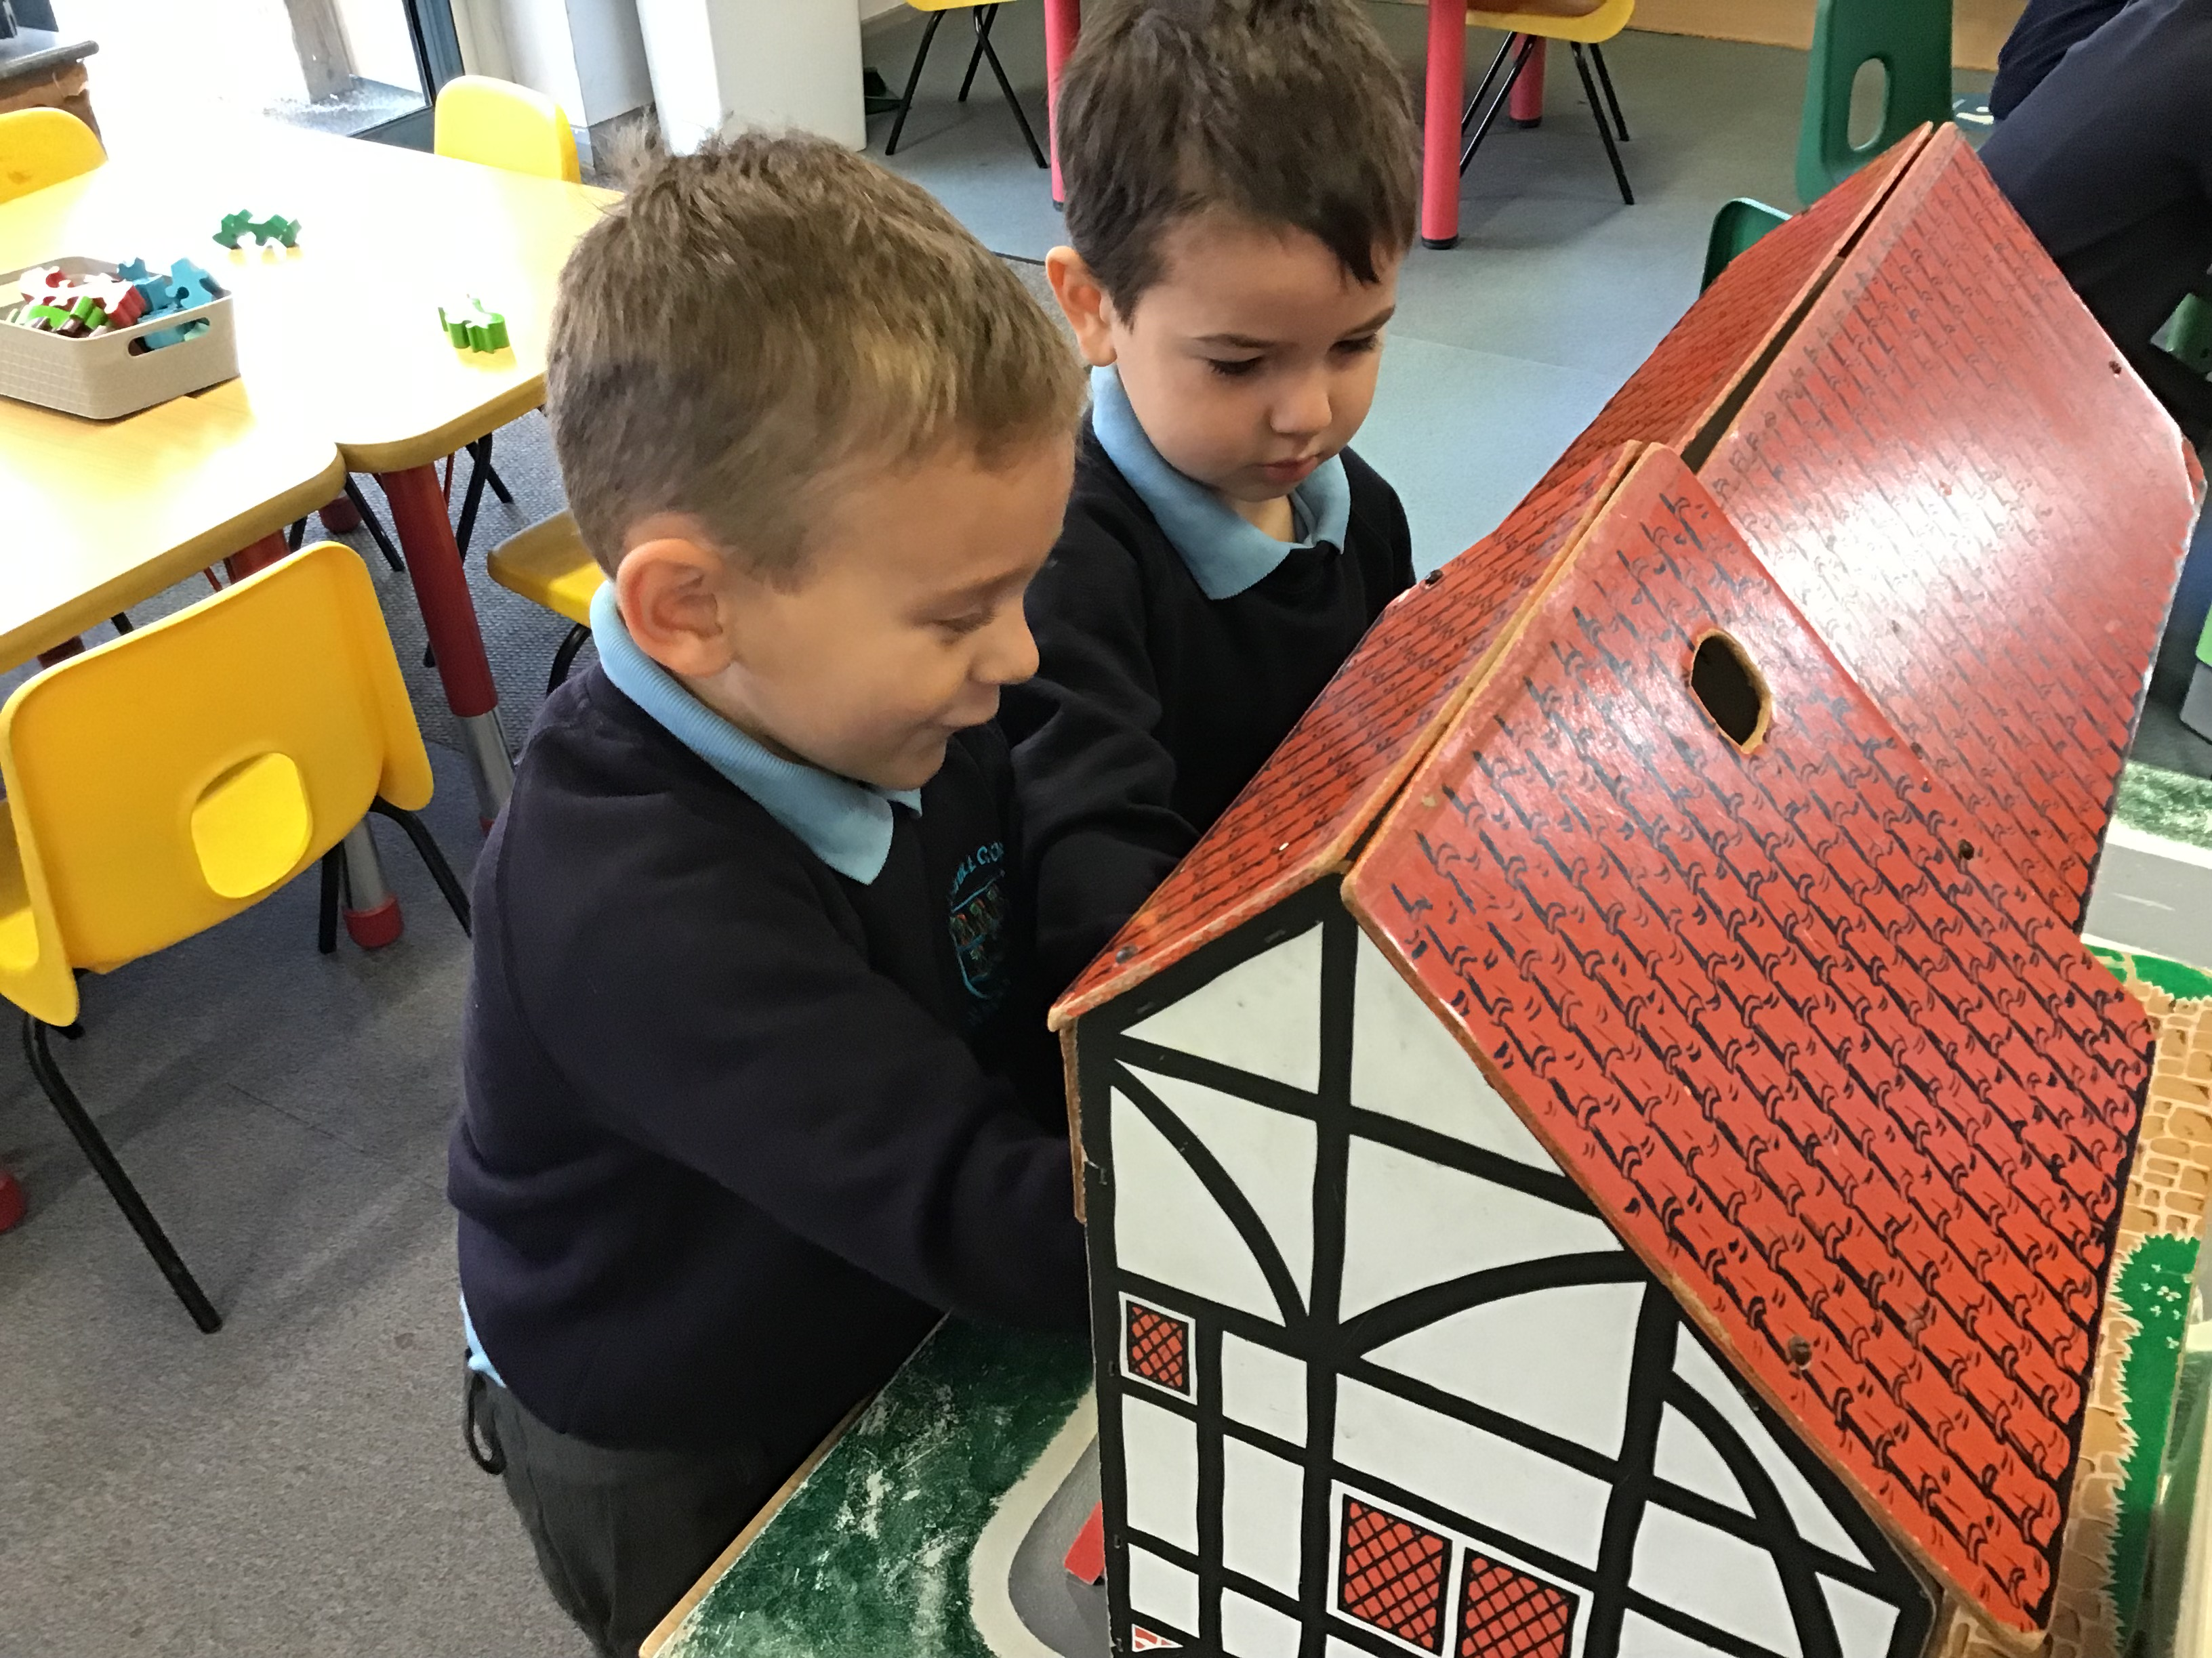
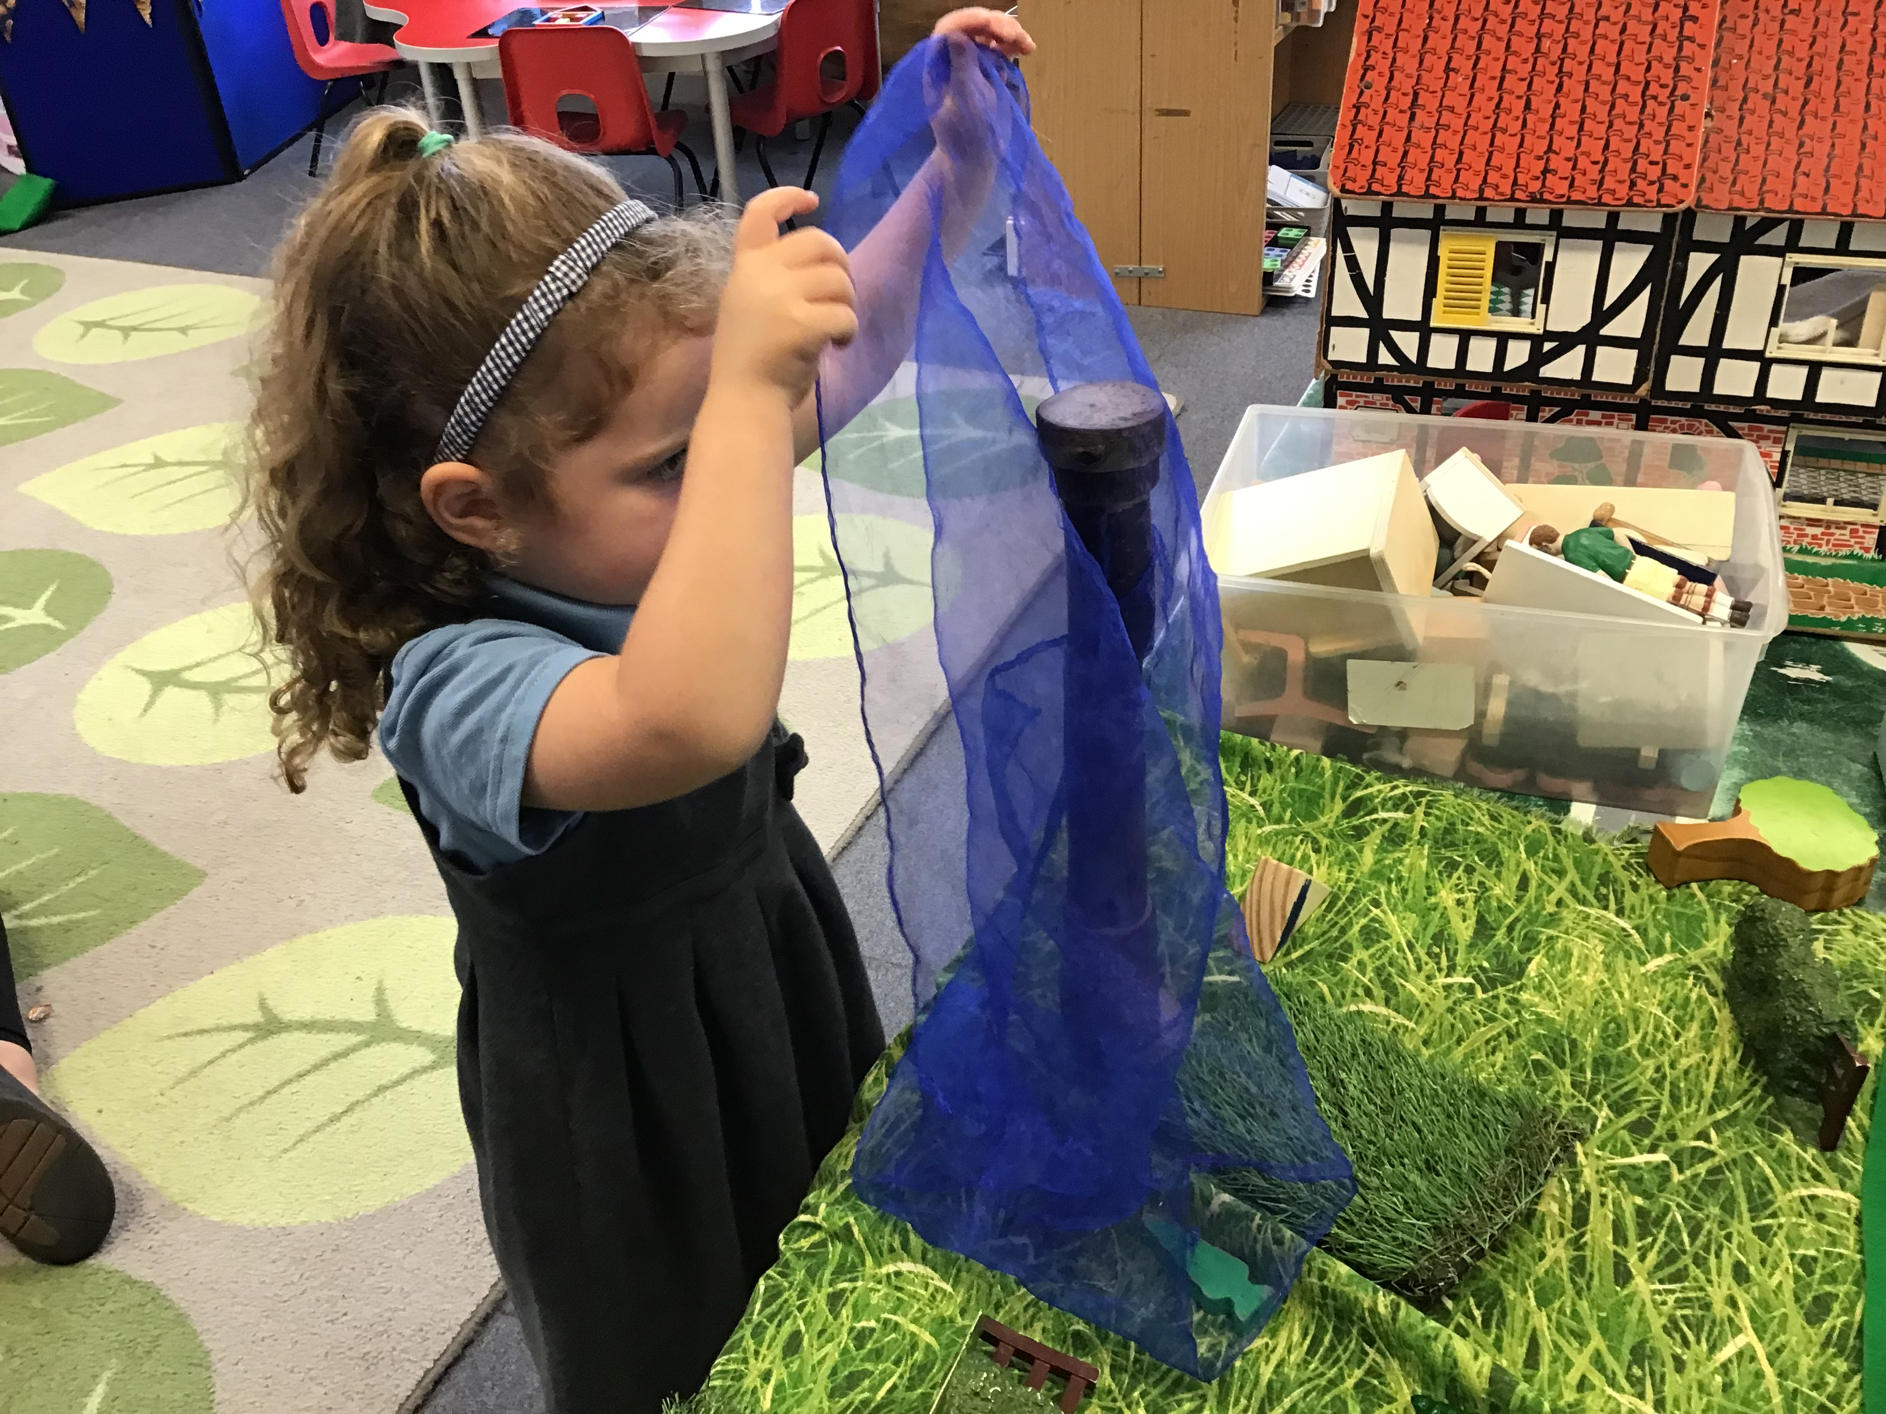
We have been having great fun settling in!

Slide 3
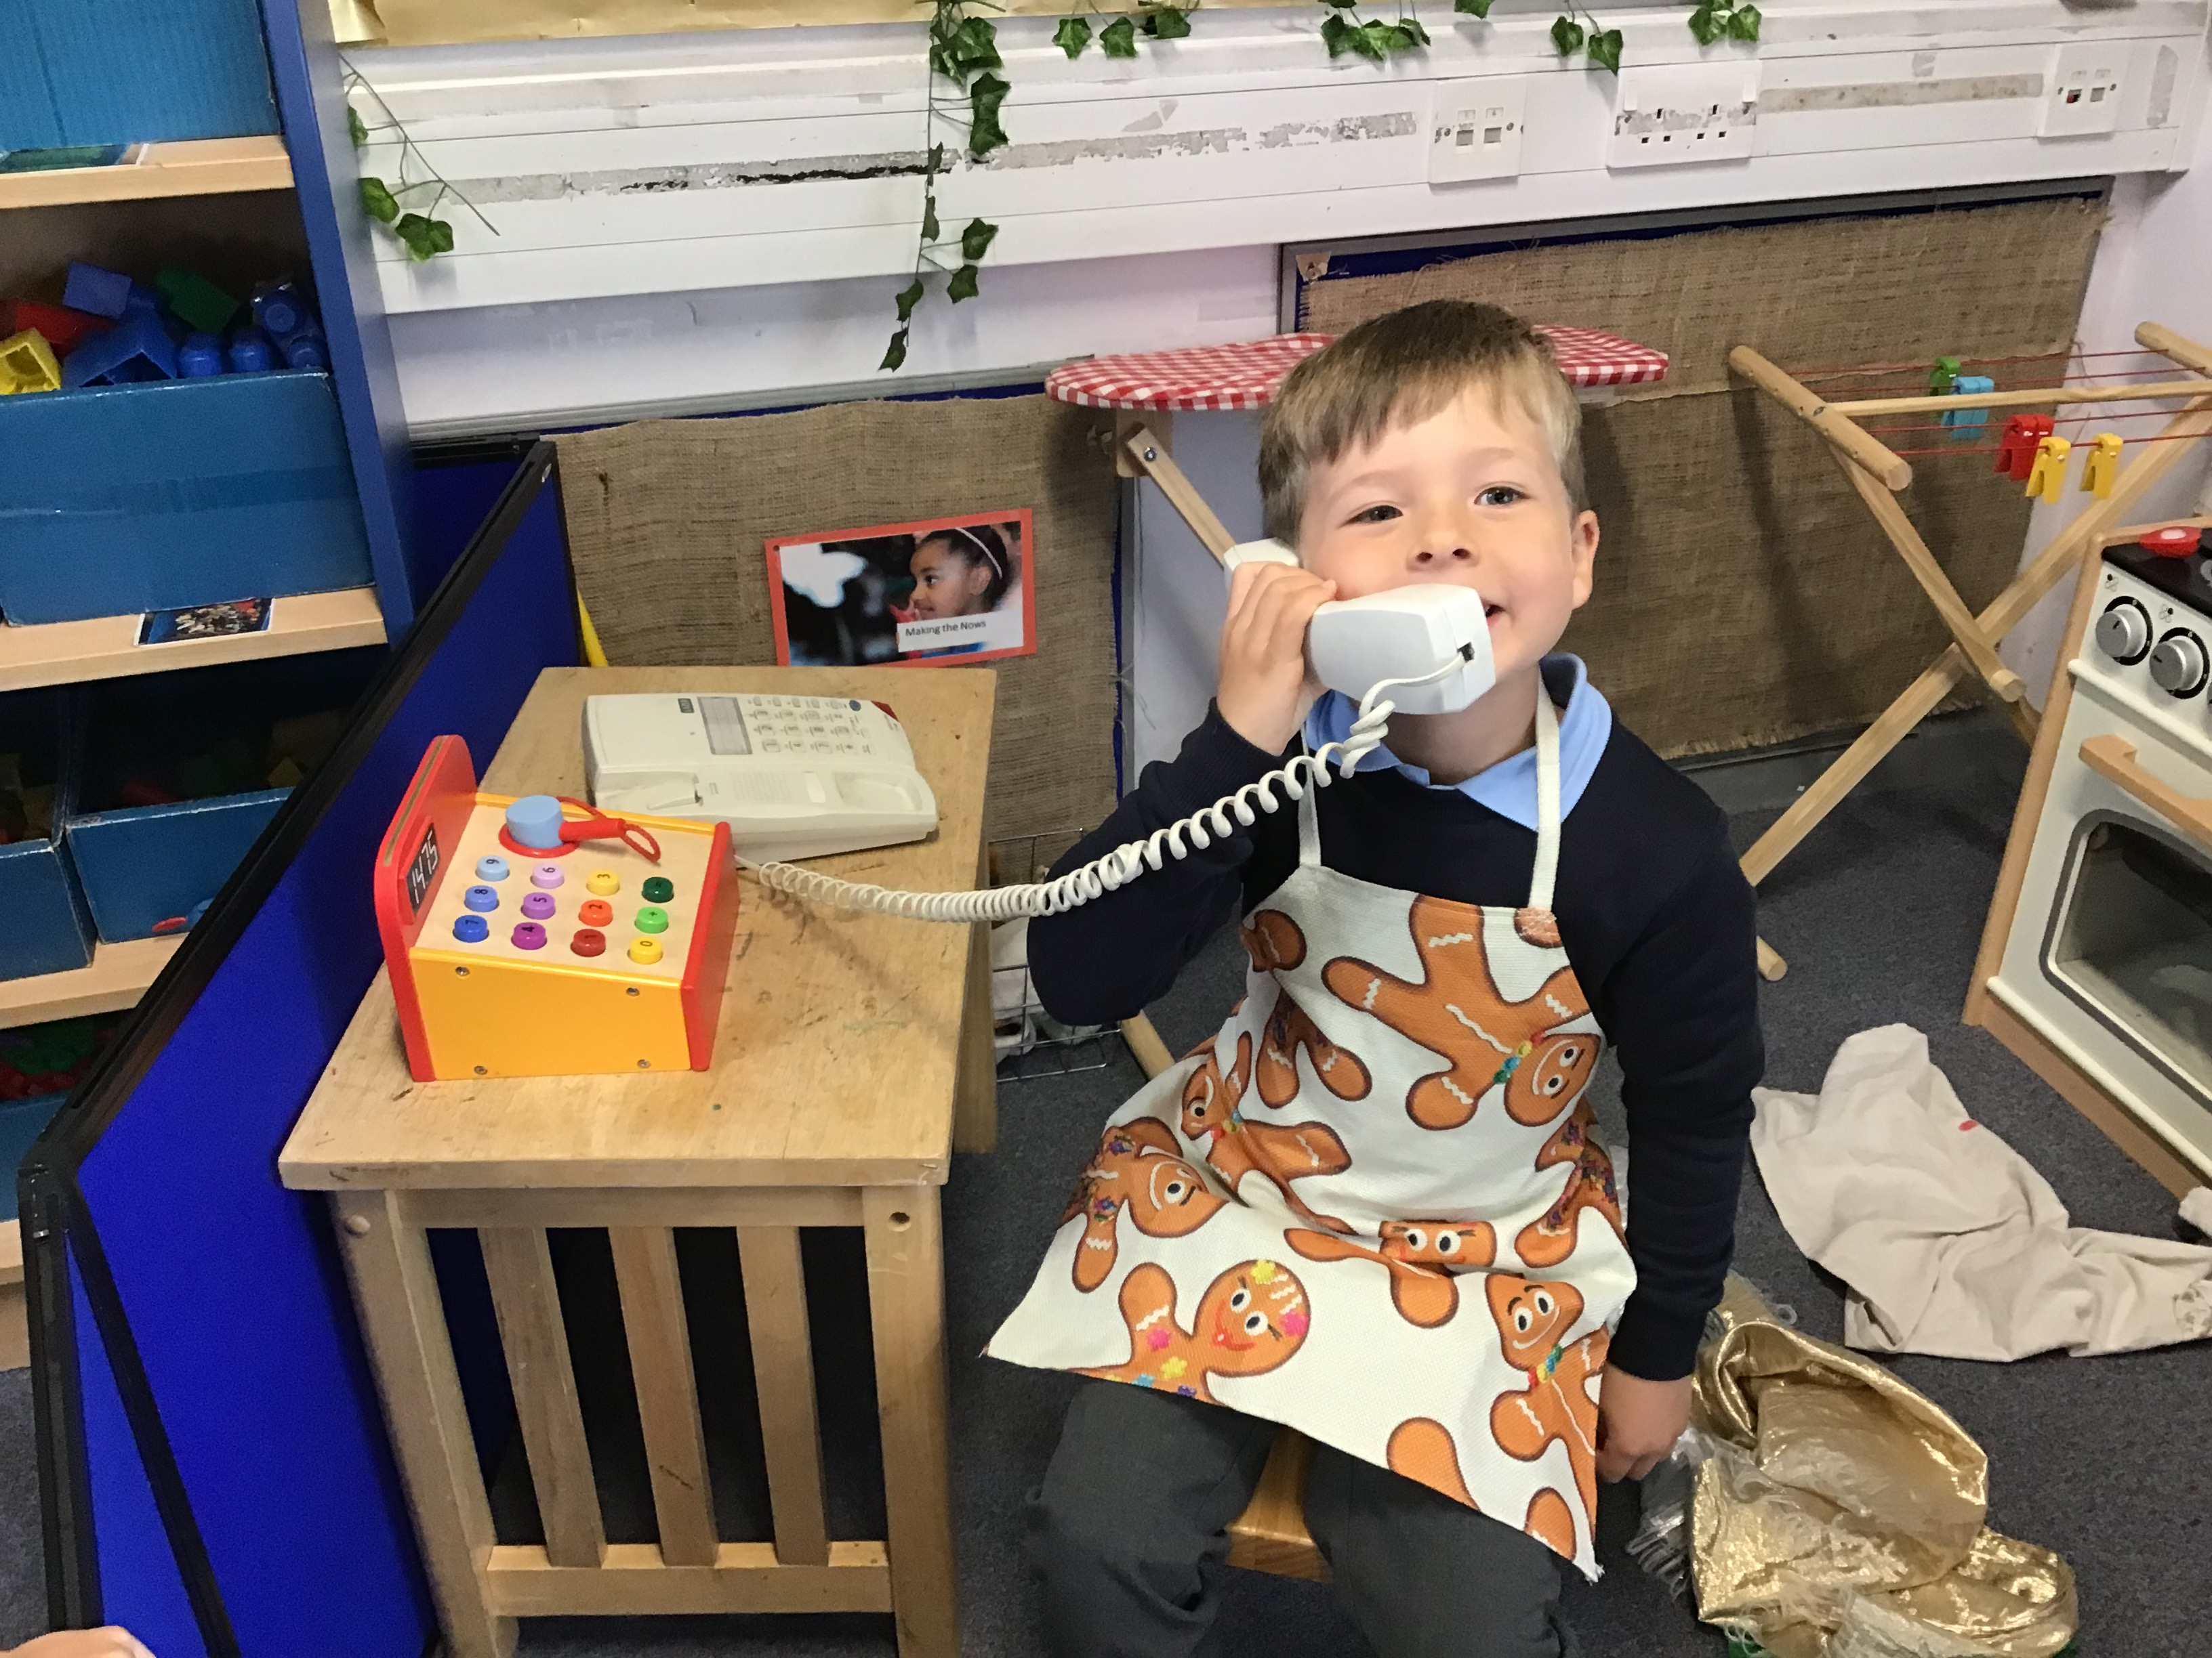
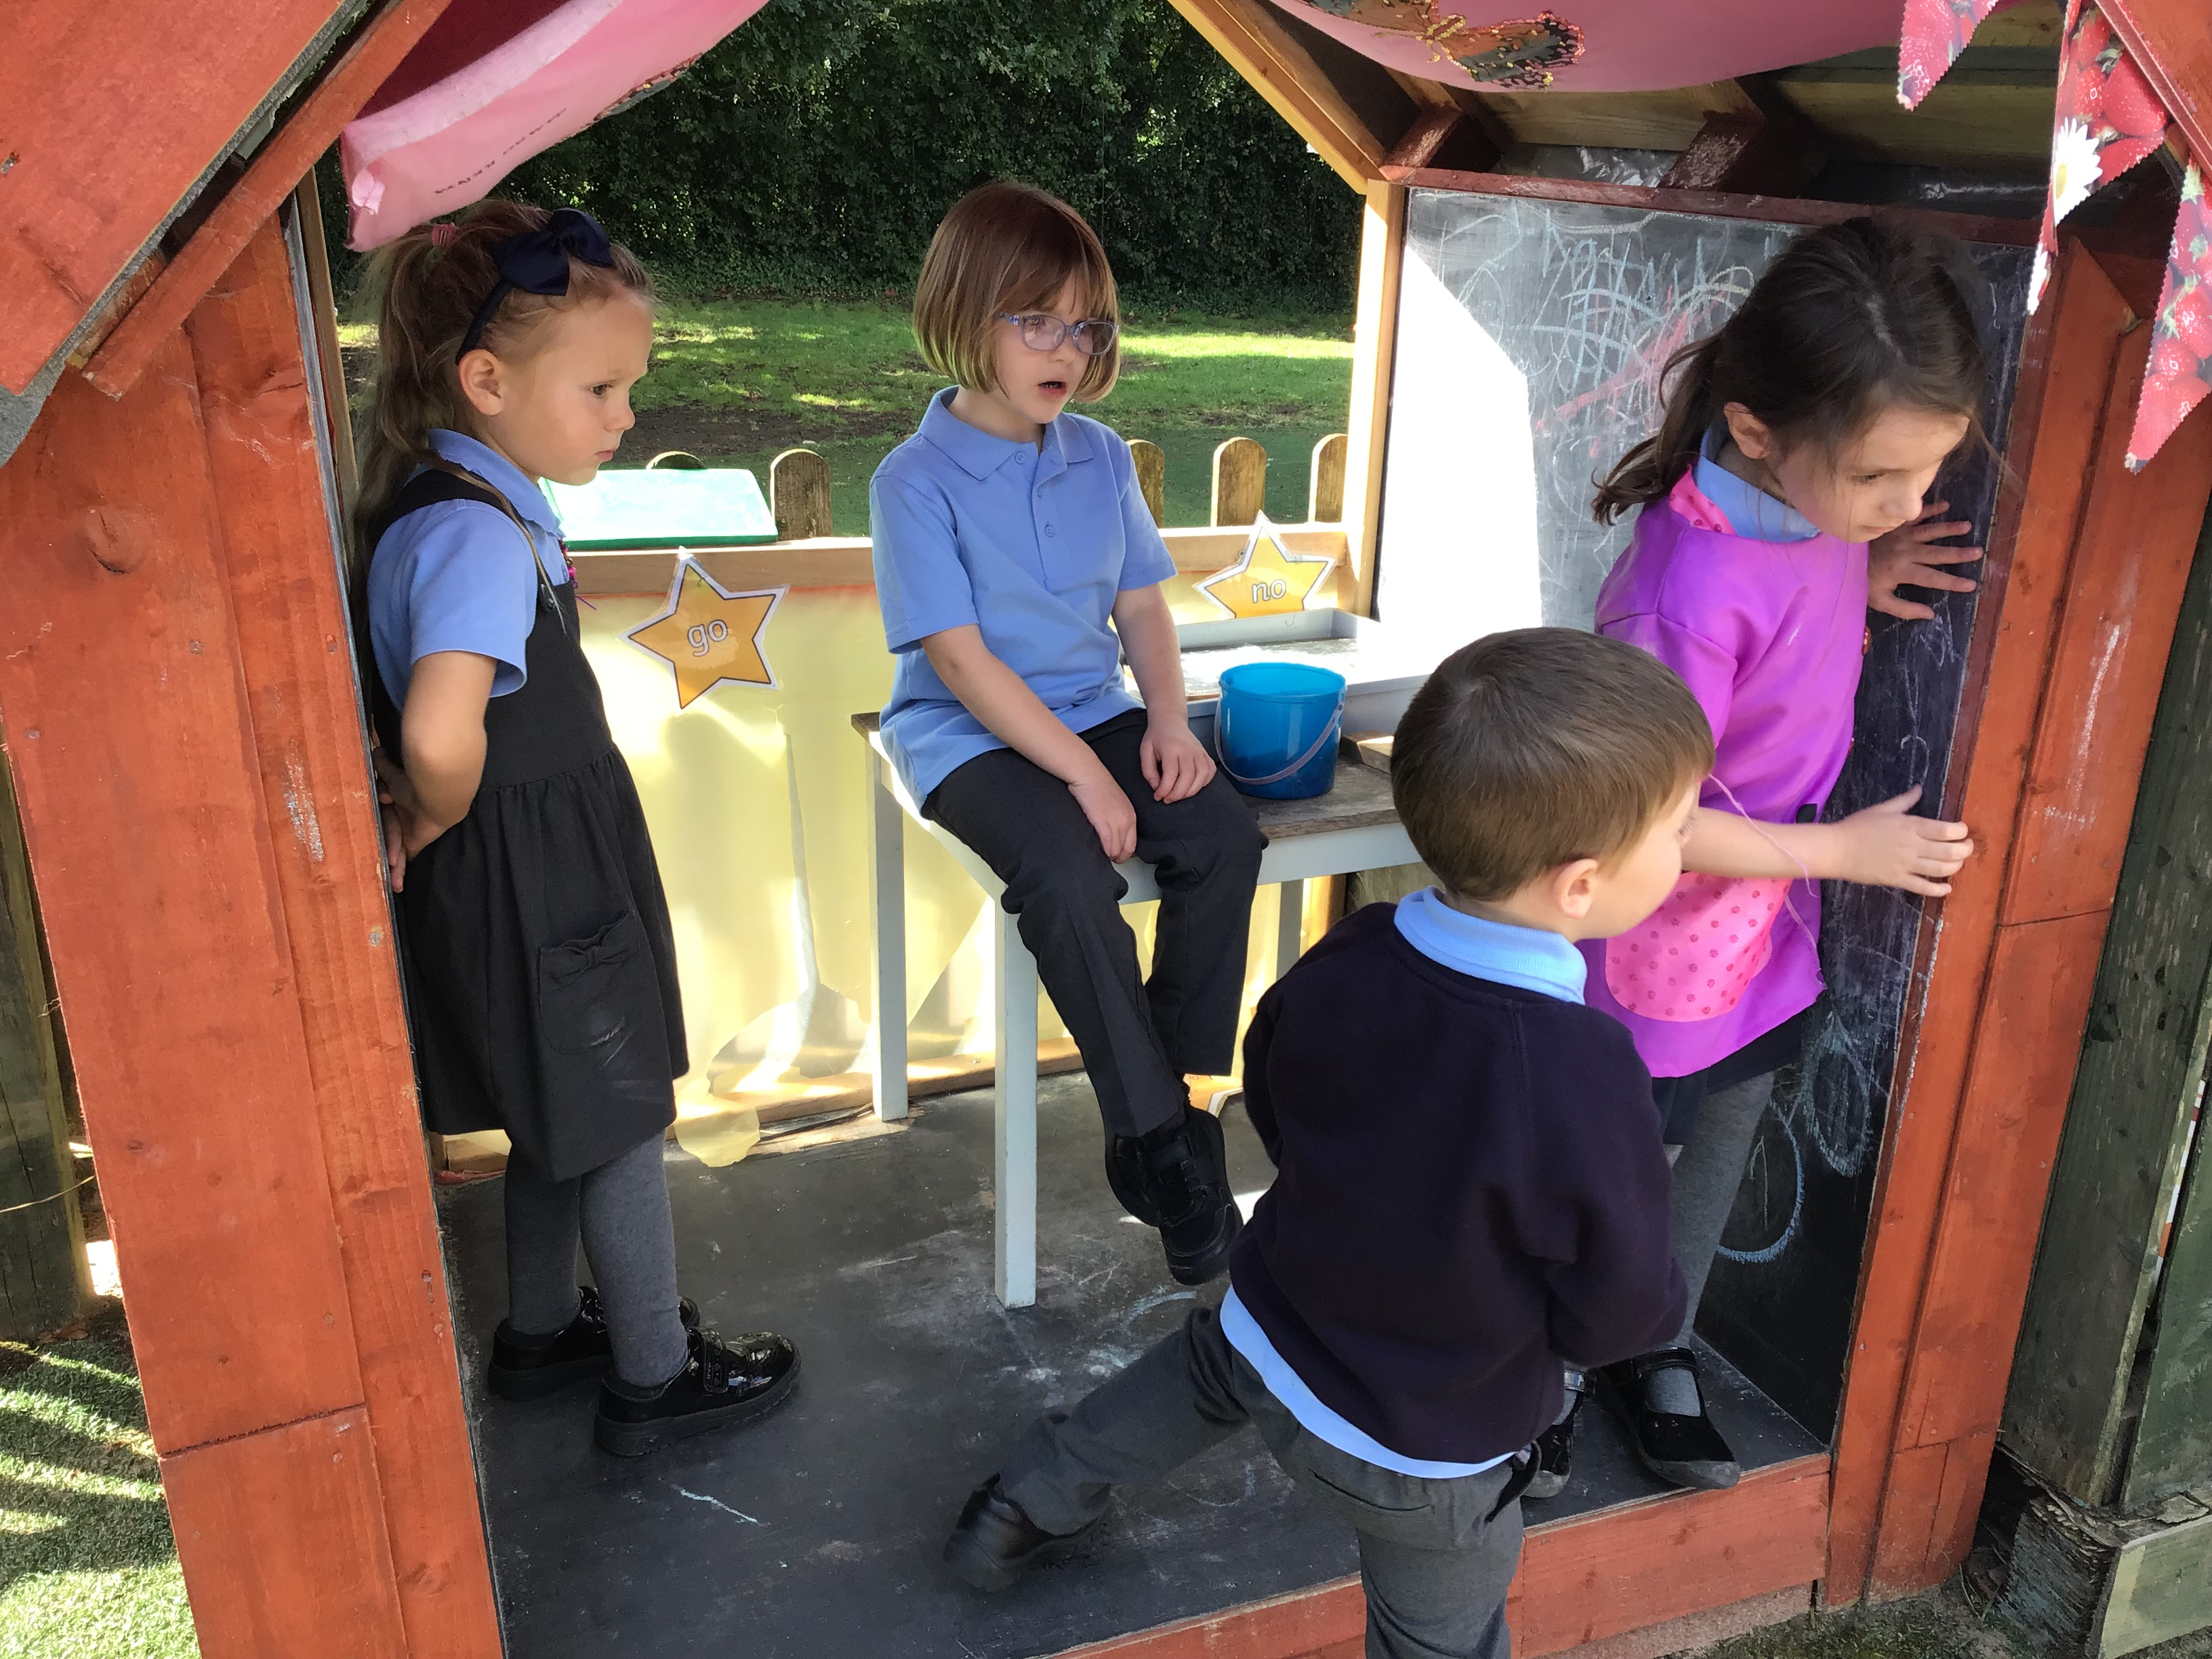
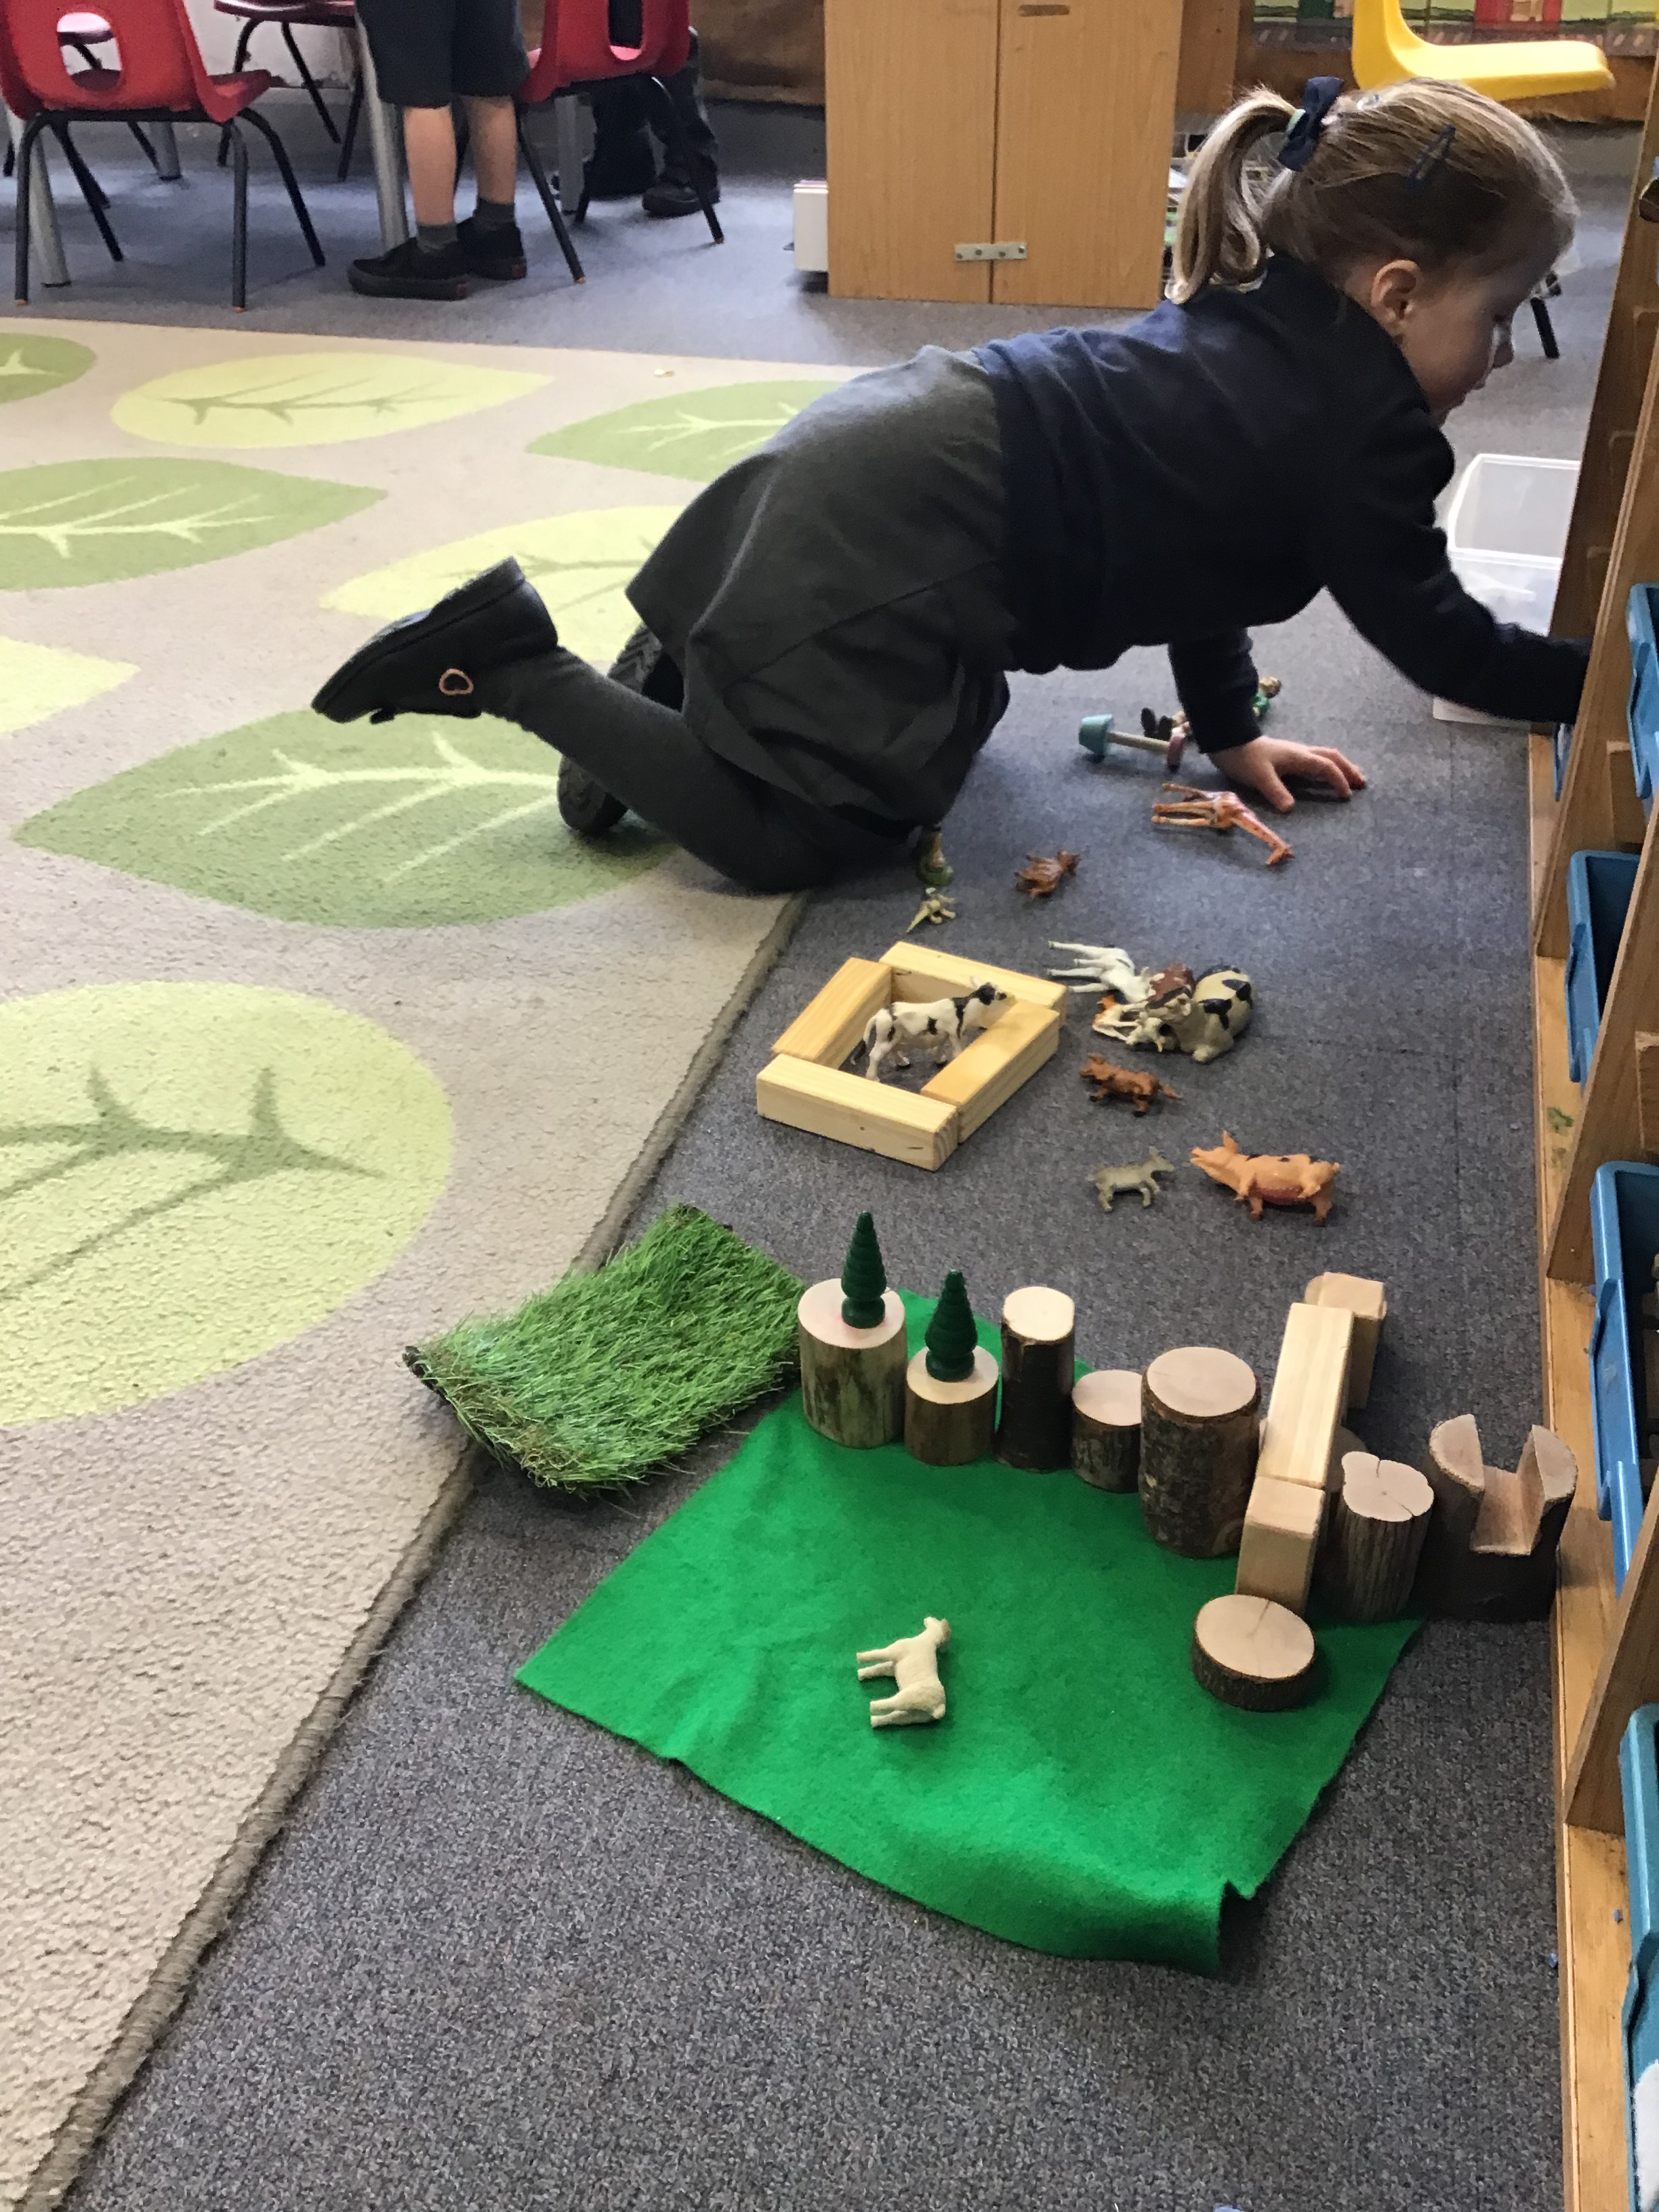
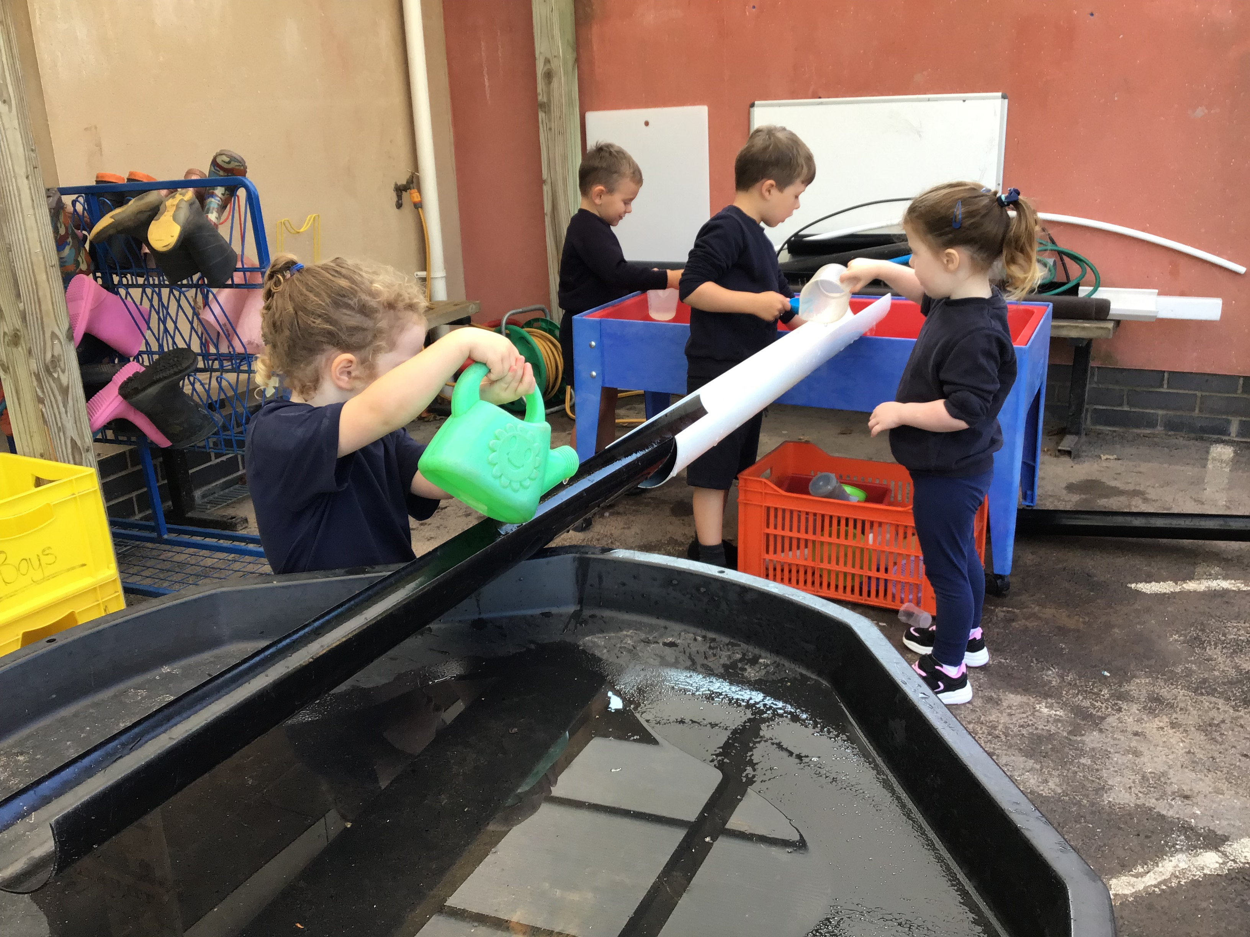
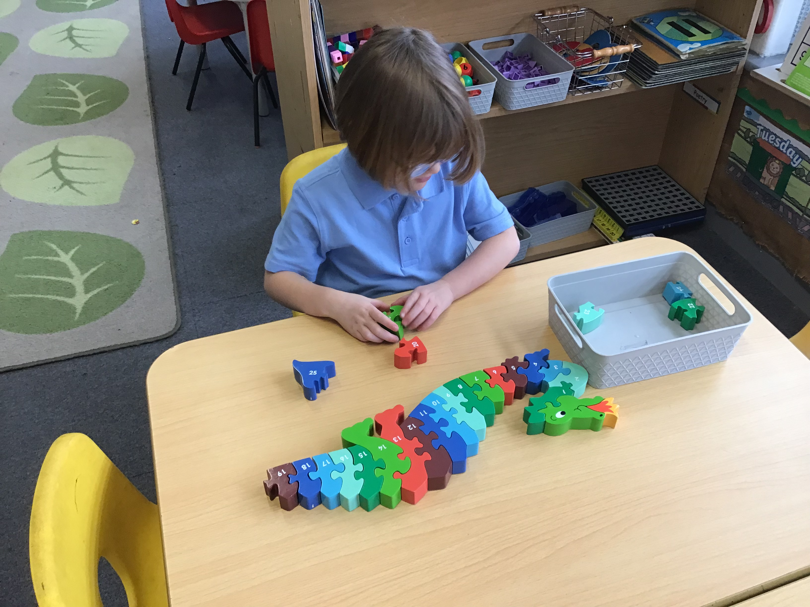
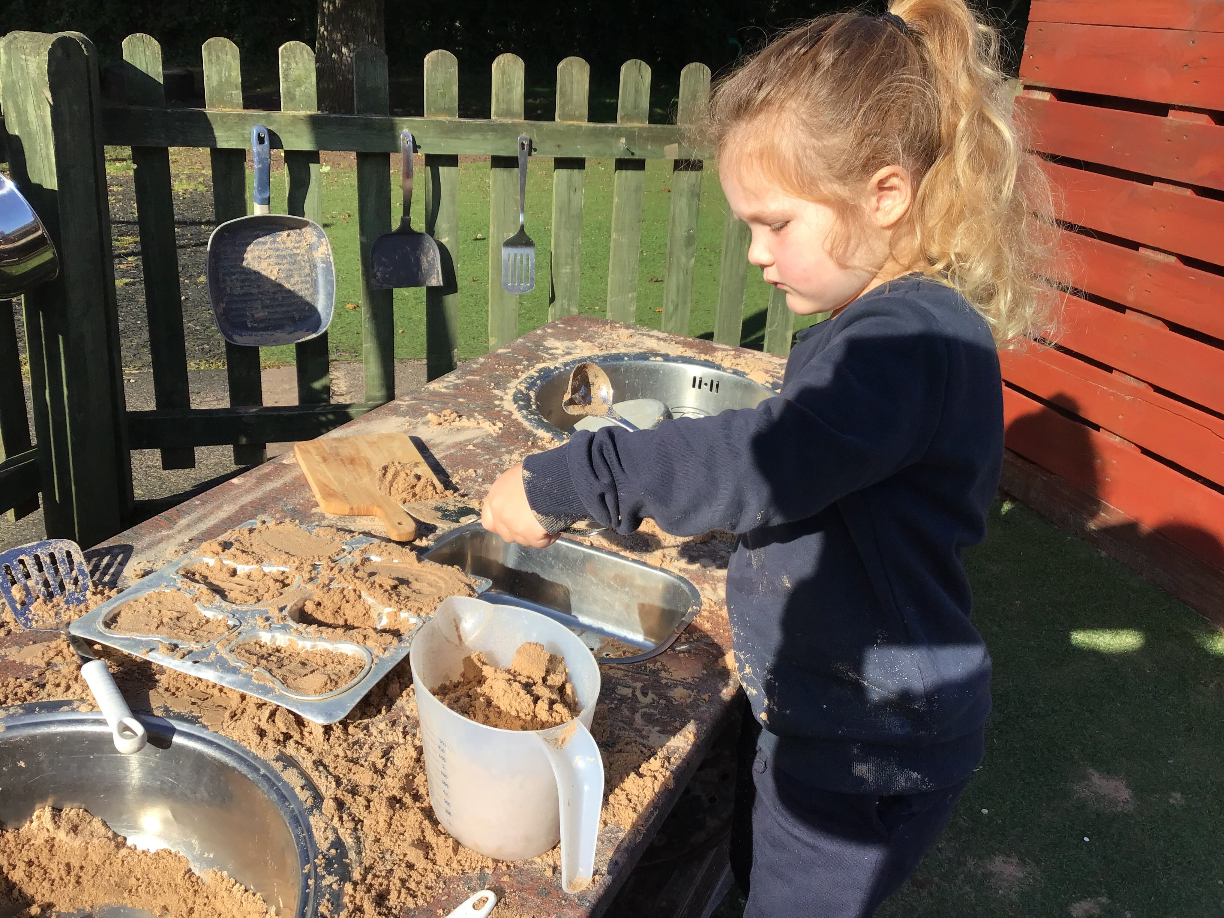

Slide 4
Contacting School
We are on the gate each morning for quick messages.
If you ever have a concern or query, please don’t hesitate to get in touch with by emailing the School Office. We’ll endeavour to get back to you within 48 hours.
If you need further help, your concern will be referred to the Key Stage Leader and if further escalation is needed, the Deputy Headteacher and/or Executive Headteacher.
Volunteering- if you’d like to help within school, please contact the School Office!
LP

Slide 5
Our Focus Over the first few Weeks…
Getting the children settled in our school environment
Making new friends
Ensuring Positive Behaviour; kind hands, kind words
Listening to each other, not talking over others
Crossing our legs on the carpet for learning time
School day routines
LP

Slide 6
Tutshill Vision and Values
‘Love One Another, Know Ourselves, Believe and Grow’
Our aim is to give your child the best quality education
~Forgiveness ~Compassion ~Respect ~Responsibility ~Creativity ~Perseverance ~Courage
Key Learning Behaviours;
Be….
Reflective, Evaluative, Cooperative
Resilient, Resourceful, Take Risks, Curious
NF
Notes:
Our vision is something that the children are encouraged to fully embrace. Everything we do is about developing this amongst our whole community. Governors, teachers, volunteers, parents and children
It sets out expectations for our language, behaviour, attitudes, learning and ultimately our characters.
We want our children to be recognised by their qualities as people as well as the quality of their academic education. everyone within the community believes and works to these standards, so that people recognise our children,
The children, staff, parents, governors are walking ambassadors for the school- they sell the school by the way they are, by their pride, politeness, attitude towards others. We spend a lot of time developing an understanding of our vision and values
It is important to us that everyone fully understands what love one another, know ourselves, believe and grown means.
The way we speak to each other and expect others to speak to us
Teach the values with each one focused a focus each term. Linked with Bible stories, world news, global and British issues.
Values become part of our learning approach and we have devised a method of allow children to think of the values which drive our school as linked learning behaviours- how are the values shown in their learning.
Develops an independence, responsibility for learning
We work to ensure that children joining the secondary school are recognised by their attitude, the way they learn their values
Our repitation goes before us and we are pleased that you have chosen to join with us.

Slide 7
A typical day in Reception
8:40 ~ first bell rings-
8.45 Good Morning, Registration, singing and book time
9:00 ~ whole class maths session
9:10 ~ up and busy- activities with adult.
10.00 – tricky words/ whole class reading input
10.10- milk and playtime
10.30 –phonics whole class input
10.40 –phonics group work- up and busy
11.30- group reading activities- up and busy
12.00 ~ story
12:15 ~ lunch
1:15- ‘topic’ input
1.30 ‘Up and Busy’ and small group activities
3:15 ~ End Of Day
LP

Slide 8
How will my child be learning? ~Overarching Principles of the EYFS
Four guiding principles
Every child is a unique child, who is constantly learning
Children learn to be strong and independent through positive relationships
Children learn and develop well in enabling environments with teaching and support from adults
Importance of learning and development. Children develop and learn at different rates
NF

Slide 9
How will my child be learning? The EYFS curriculum
7 areas of learning
3 prime areas
4 specific areas
Characteristics of learning
NF

Slide 10
Areas of Learning And Early Learning Goals
Each area of Learning and Development has Early Learning Goals, which summarise the knowledge, skills and understanding that all young children should have gained by the end of the Reception year.
3 Prime Areas
4 Specific Areas
PD | PSED | C&L | Literacy | Mathematics | EAD | UtW
Gross Motor Skills Fine Motor Skills | Self regulation Building relationships Managing Self | Listening, Attention Understanding Speaking | Comprehension Word Reading Writing | Number Numerical Patterns | Creating with Materials Being creative and imaginative. | Past and Present People and Cultures The Natural World
LP

Slide 11
Assessment; How we get to know your little ones
Formative Assessment
Assessment happens daily in Reception. It is an ongoing process, involving knowing the children’s level of achievement and interests, and then shaping our teaching and learning experiences around that knowledge.
It’s really important to us that we get to know your children as individuals!
Statutory Assessment
Government baseline- completed
School based baseline- in progress
These are short assessments carried out in the first few weeks of your child starting school.
Foundation stage profile; completed in the Summer Term
A picture is built up over the year to show progress towards the Early Learning Goals.

Slide 12
Our Learning
Summer term
Me and the wider world.
Learning about things out of my experience, time, location, interests,
Autumn term
all about me, my family, my thoughts, my feelings, my ideas, my likes and dislikes
Spring term
Me and my world.
My wider family. My experiences within my community. Where I live, Tutshill Chepstow, comparison with other familiar places. Experiences familiar to me, outside of my time frame.

Slide 13
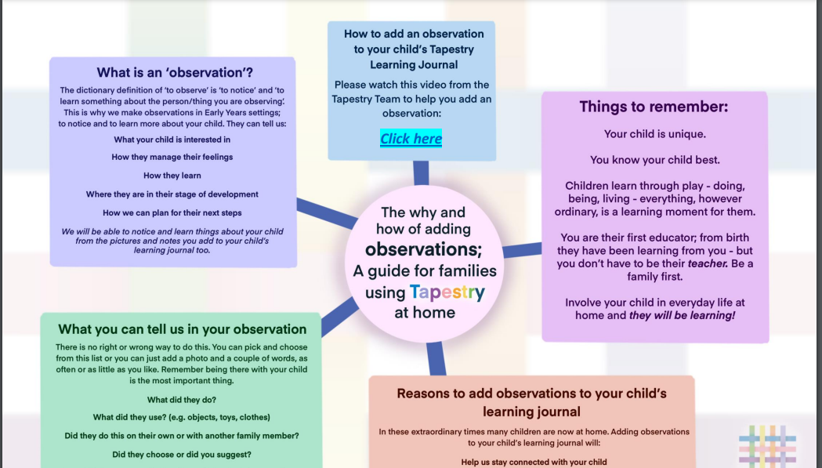
Tapestry
NF

Slide 14
Literacy
We will be inviting you to join us here for a ‘Literacy Meeting’ in which we will talk you through how we teach reading and writing to your child.
The meeting will be held here,
in Reception on
27th September
We hope you can make it ☺

Slide 15
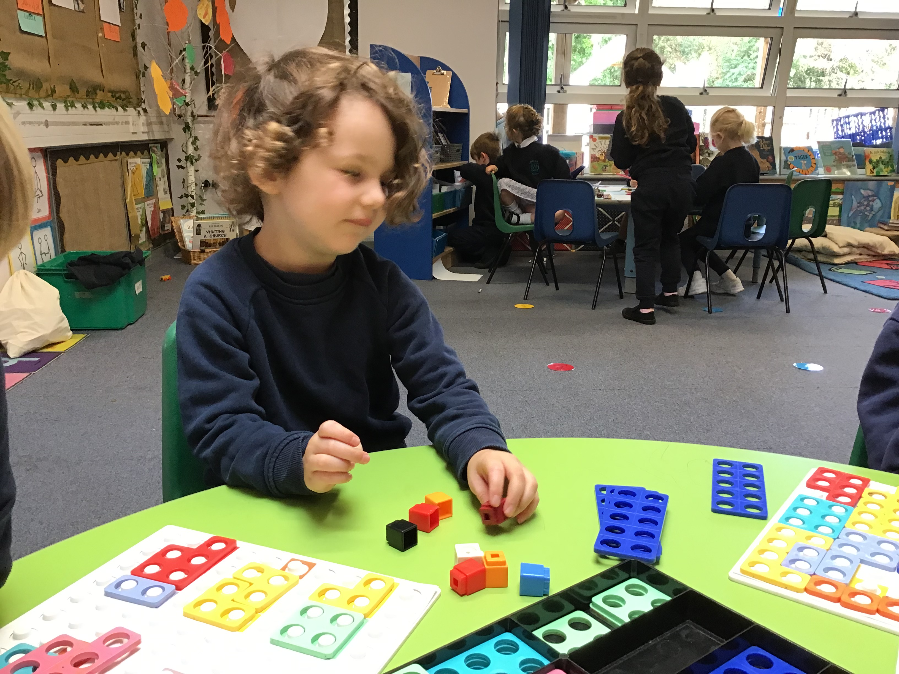
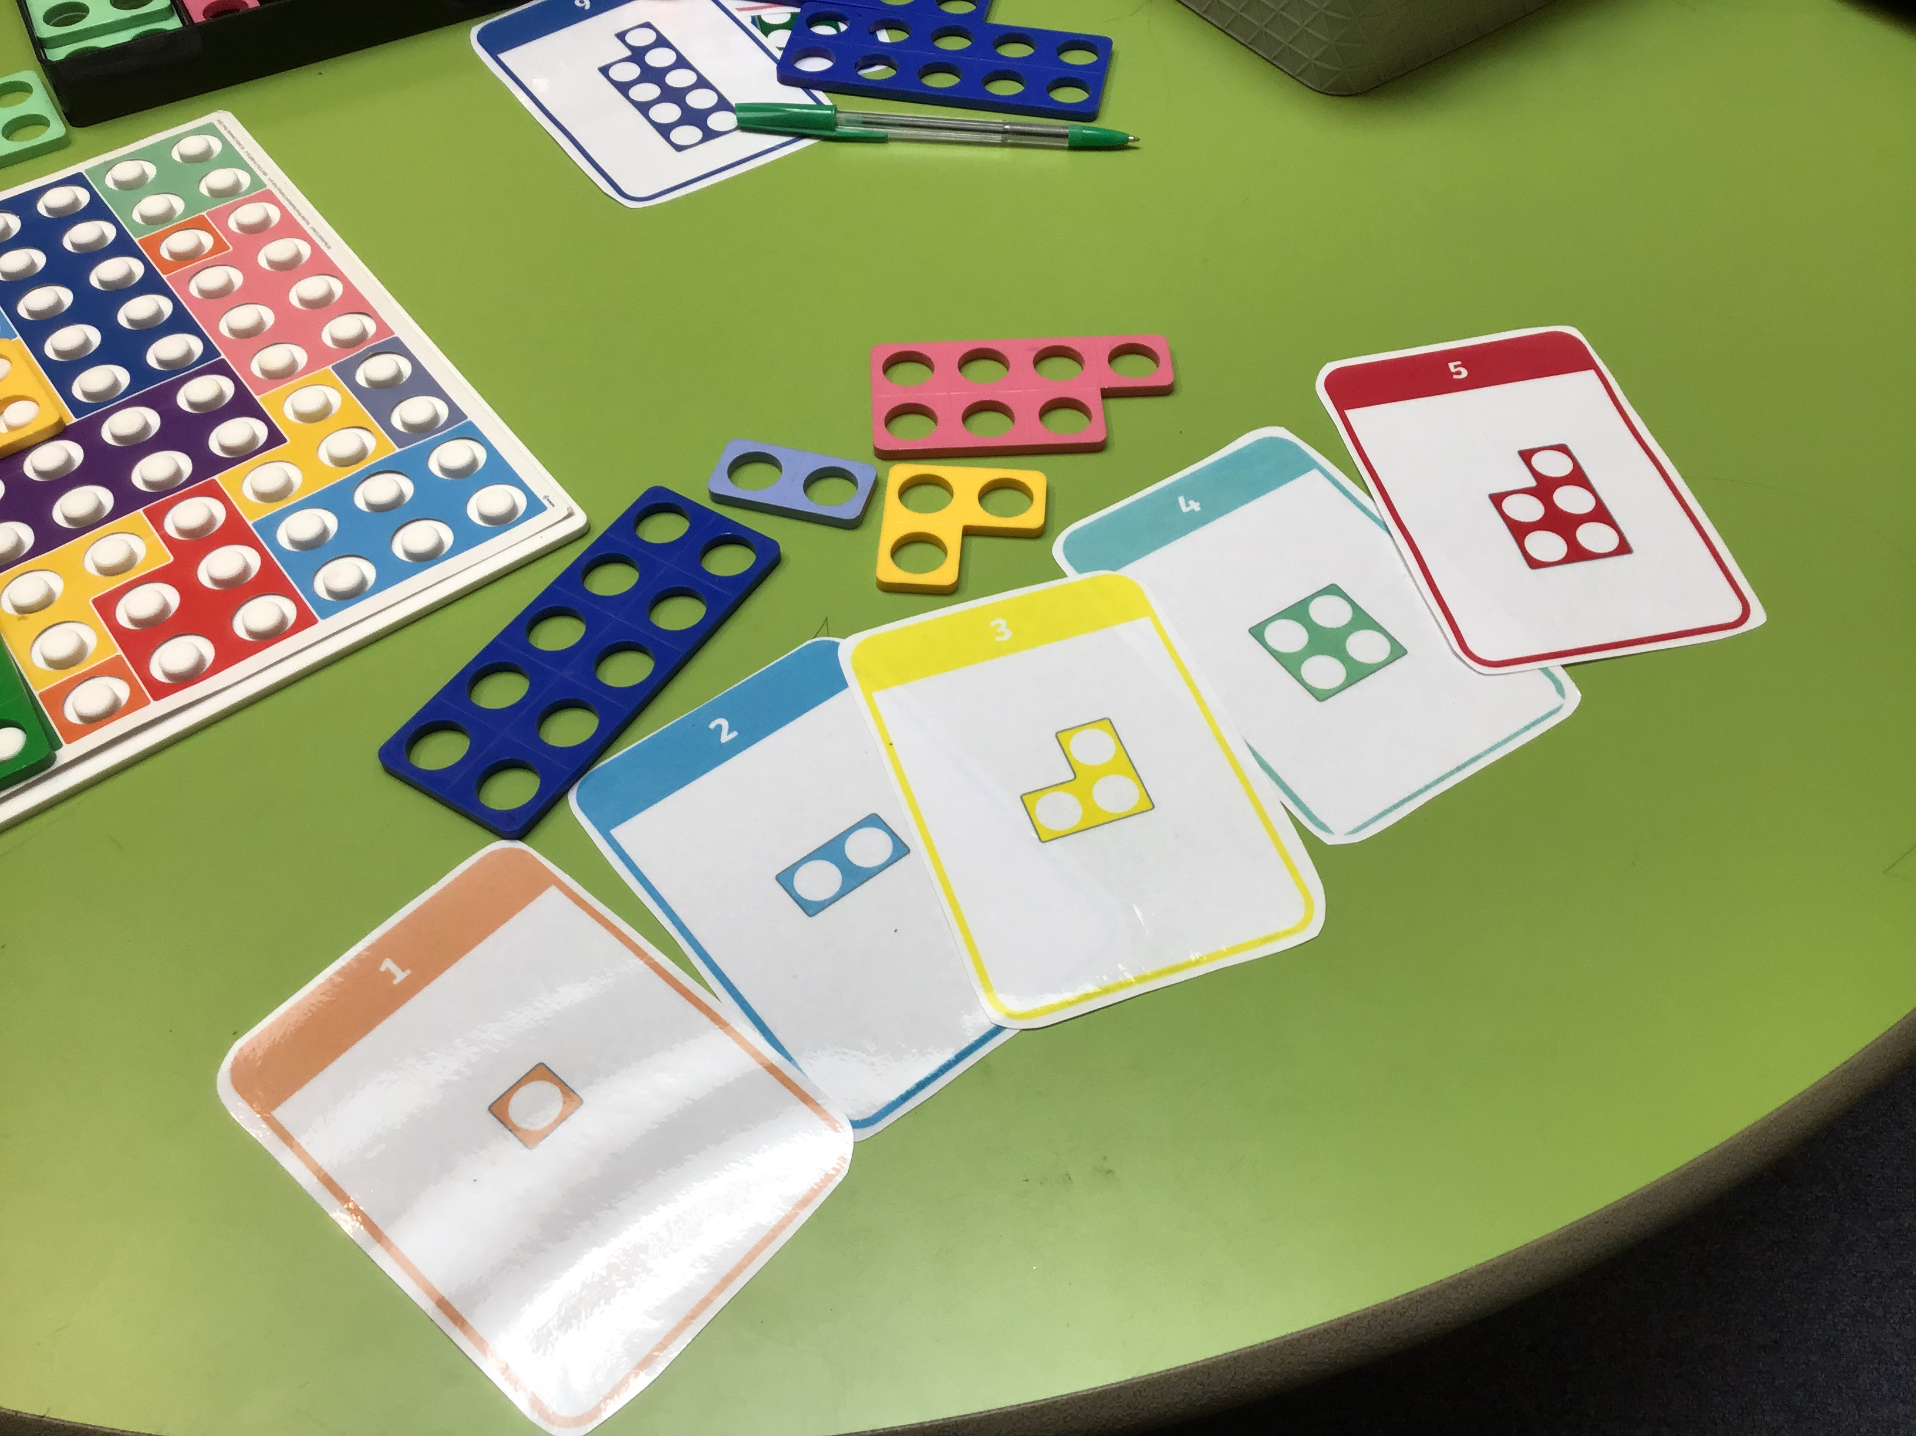
Maths in Reception
NF

Slide 16
How do we teach Maths?
Our approach is based on developing a positive attitude towards maths through a practical hands-on approach. We develop mathematical thinking and talk.
Taught through stories, rhymes, games, activities
Teaching is a mix of adult led tasks, whole class and group as well as play based learning, number rhymes, games and songs
Key skills of counting, subitising, composition, ordering, comparing also including shape space and measures and spatial reasoning,

Slide 17
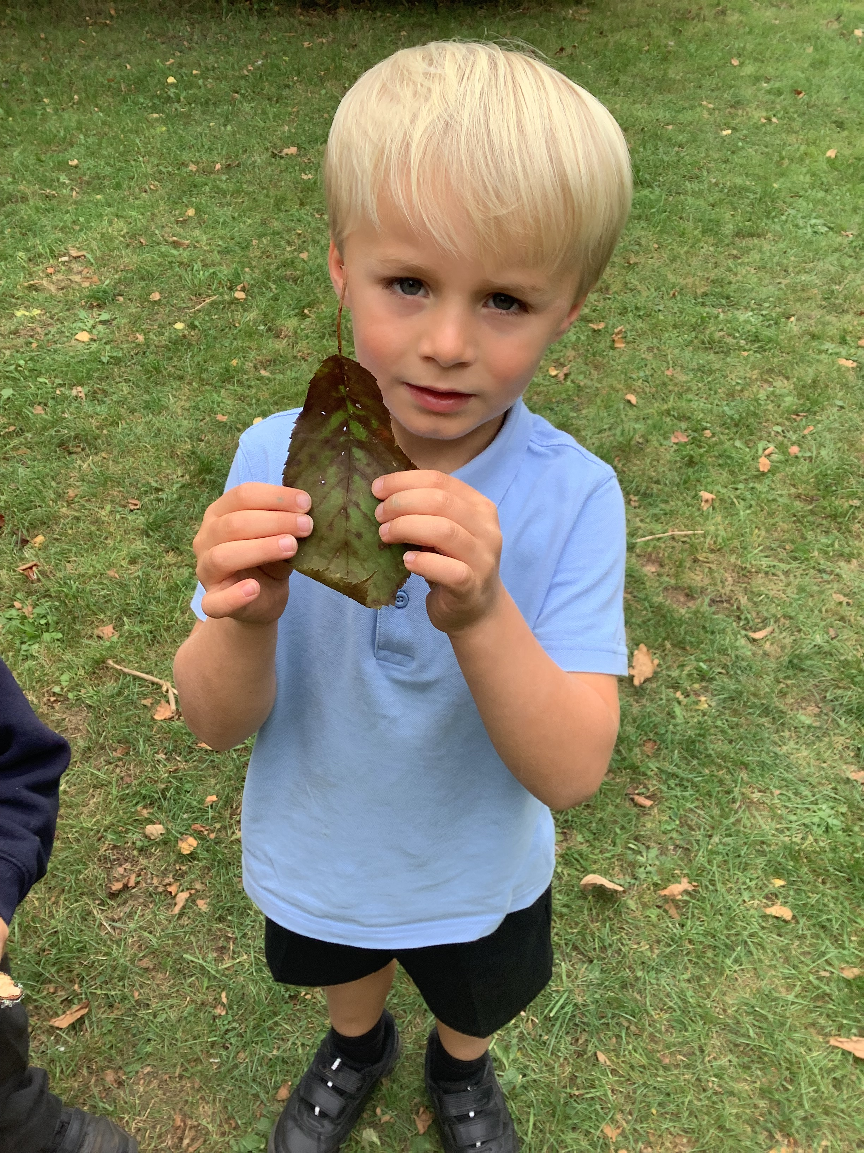
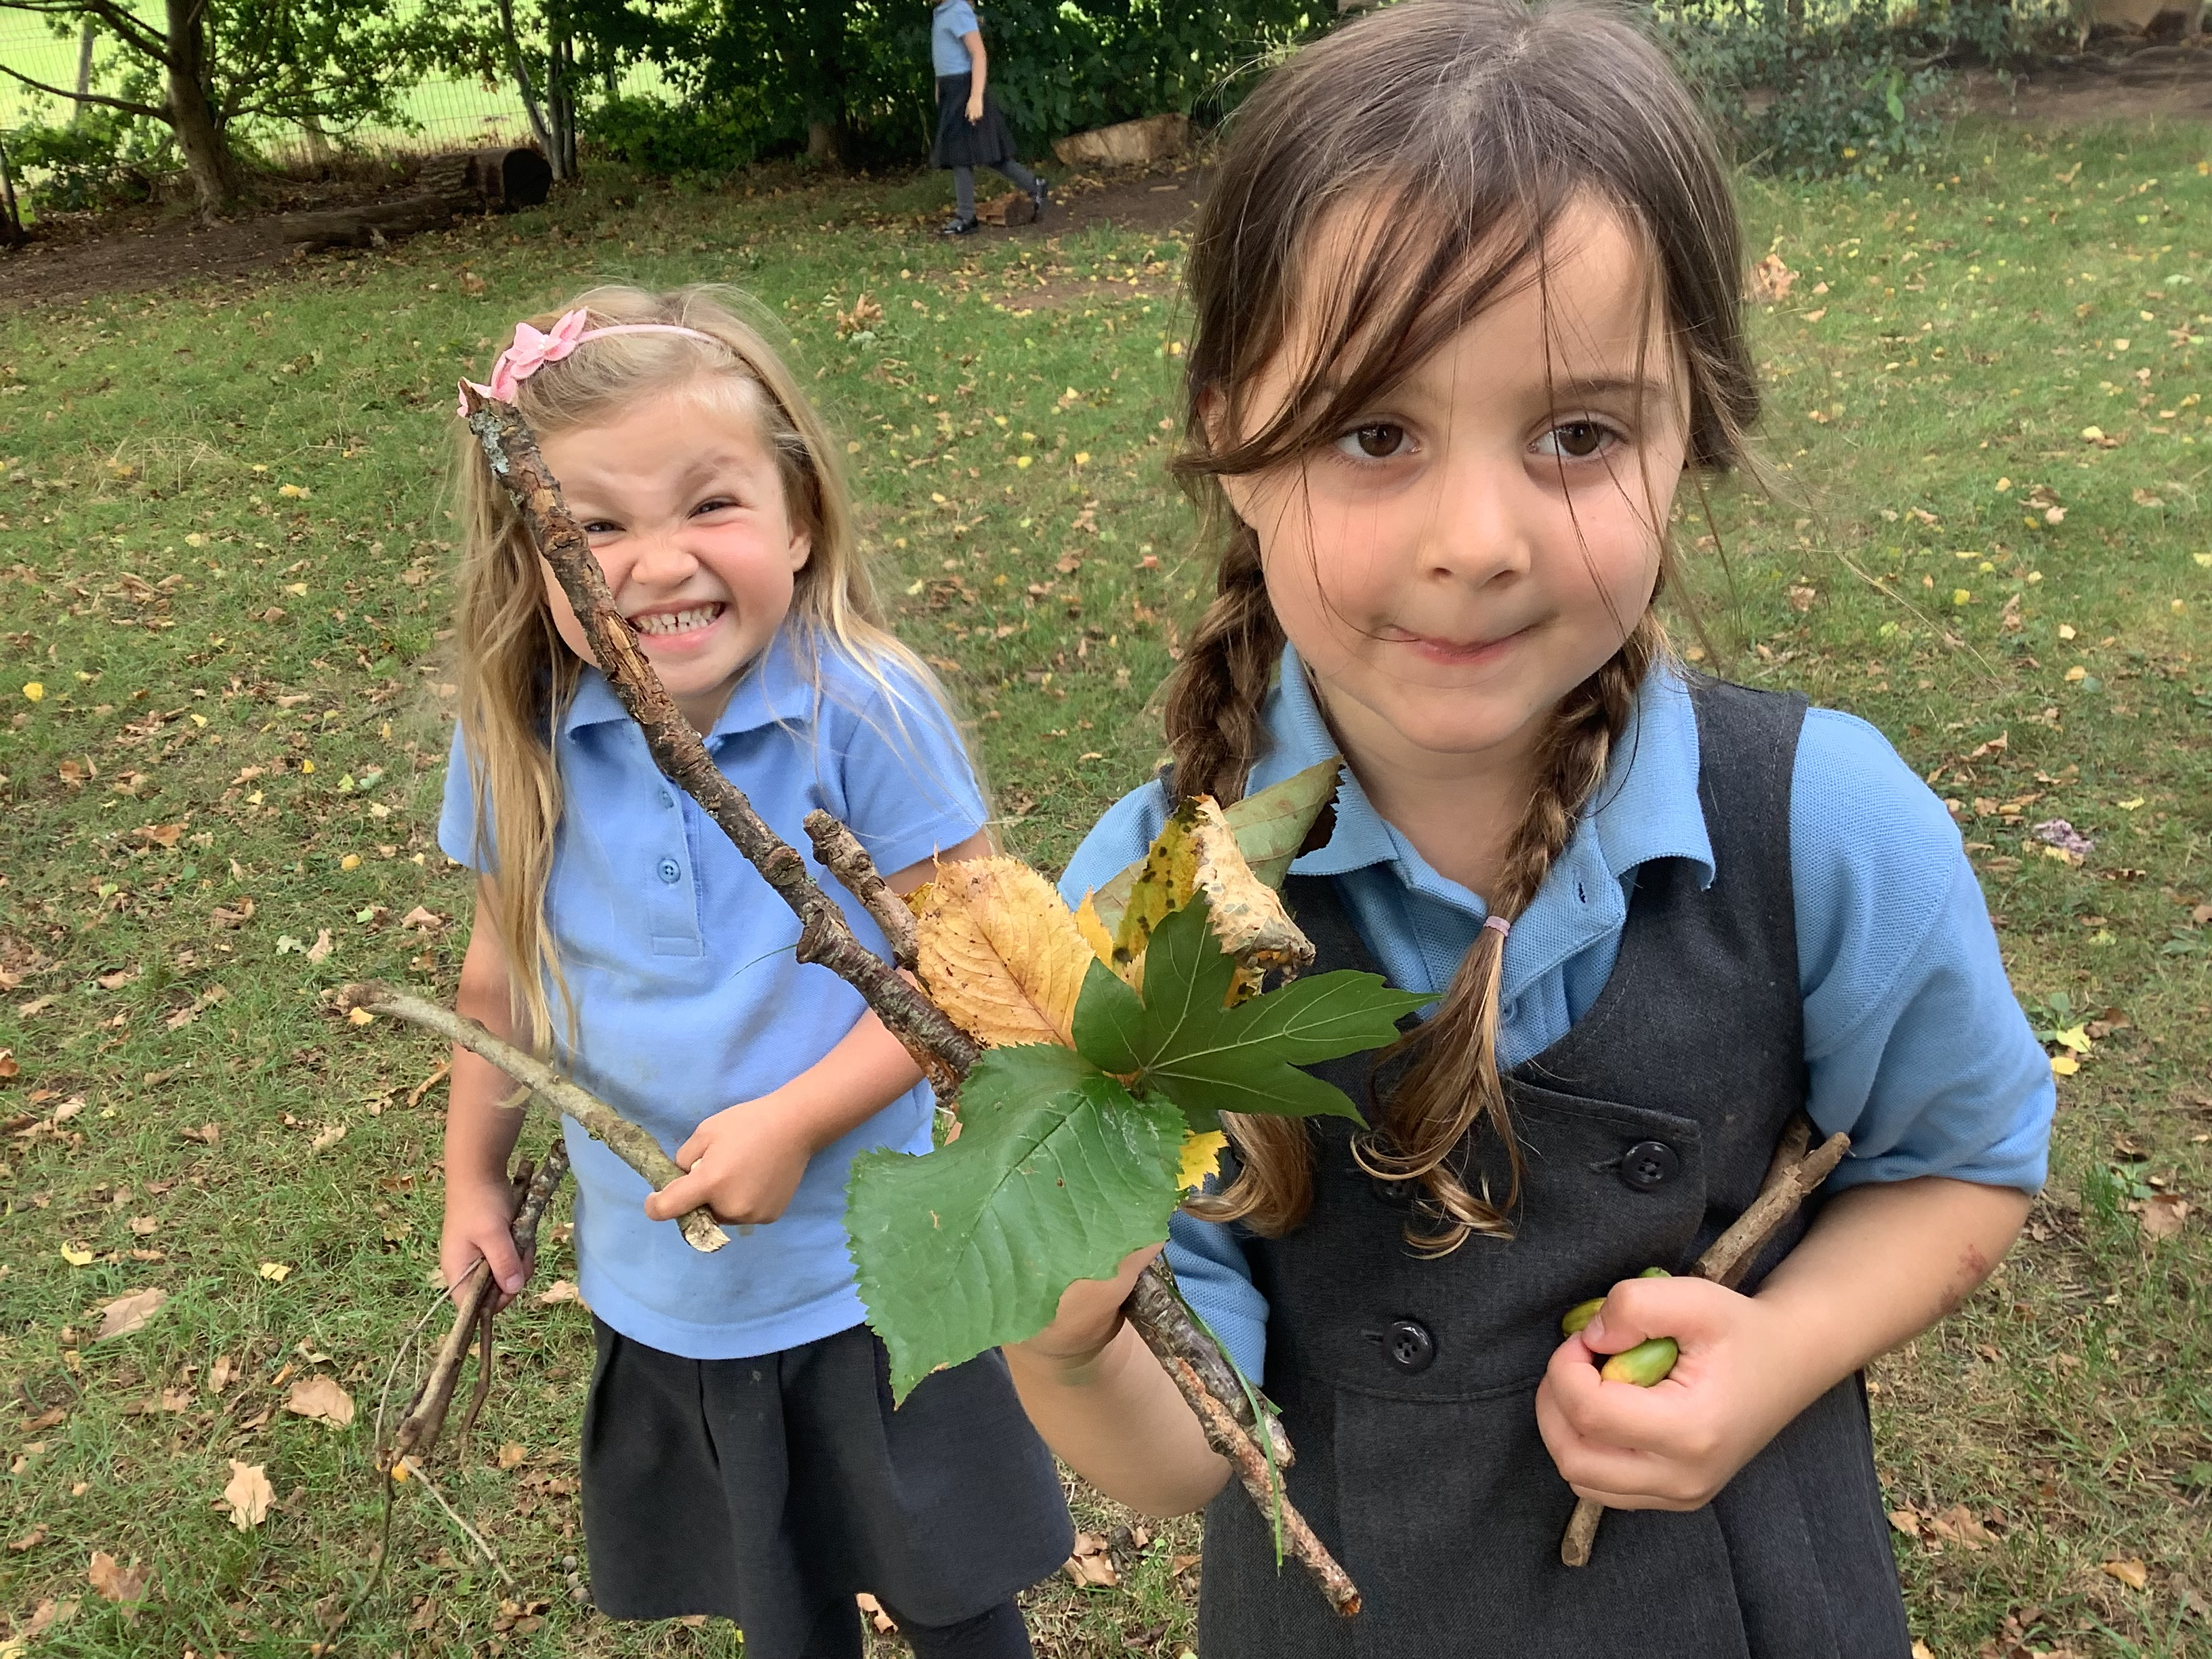
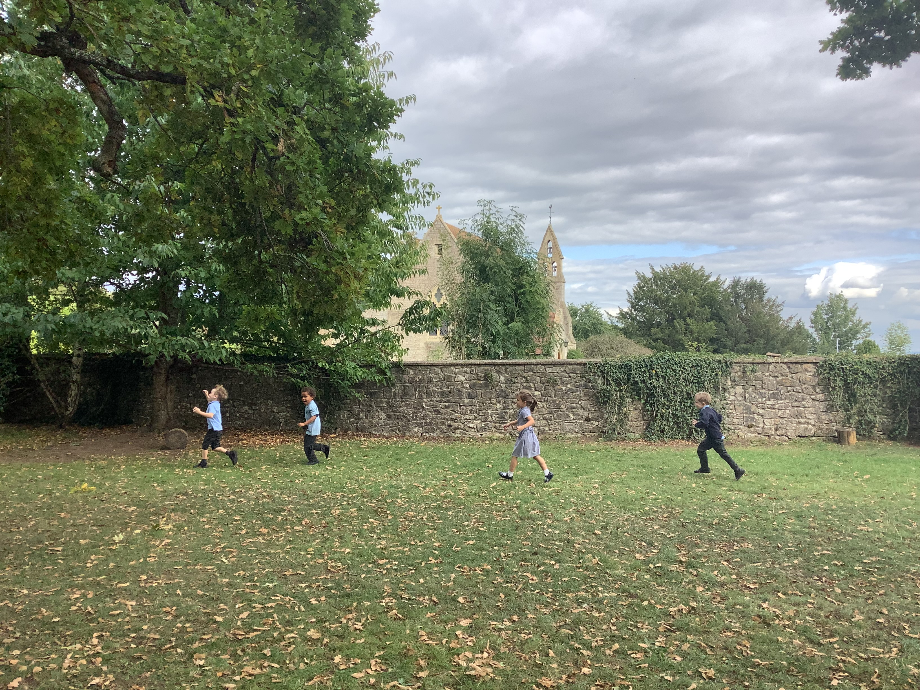
Forest School and Outdoor Learning
We are very fortunate to have such wonderful outdoor space and we do try and take learning outside where possible.
We regularly make use of the Forest School space onsite.
Therefore please ensure your child brings a coat everyday to school.
LP

Slide 18
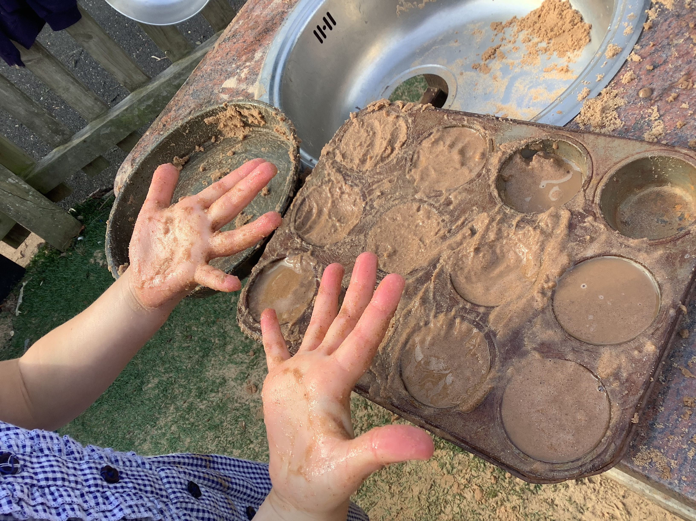
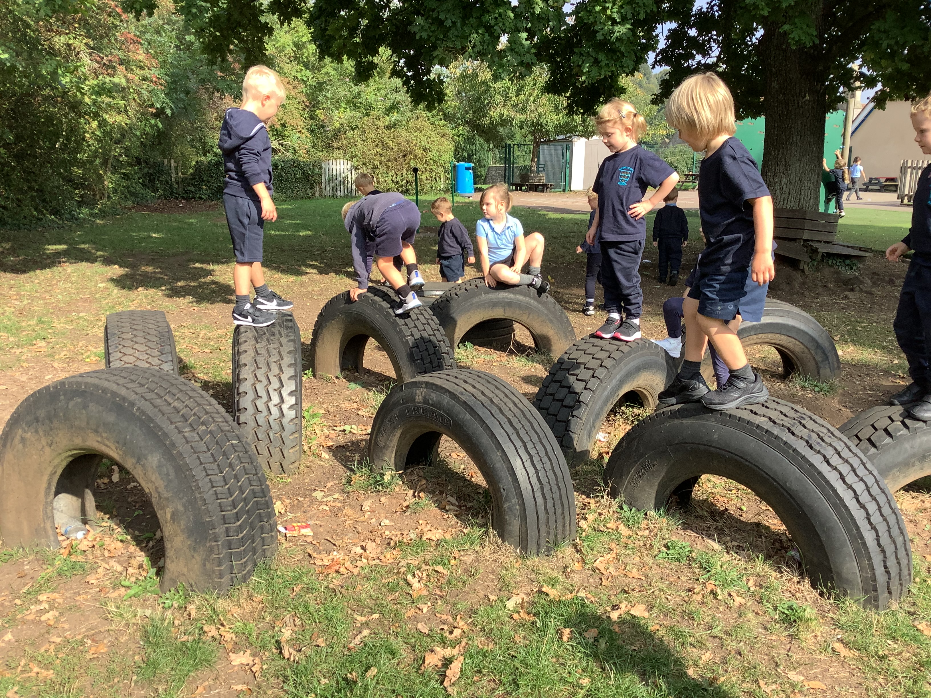
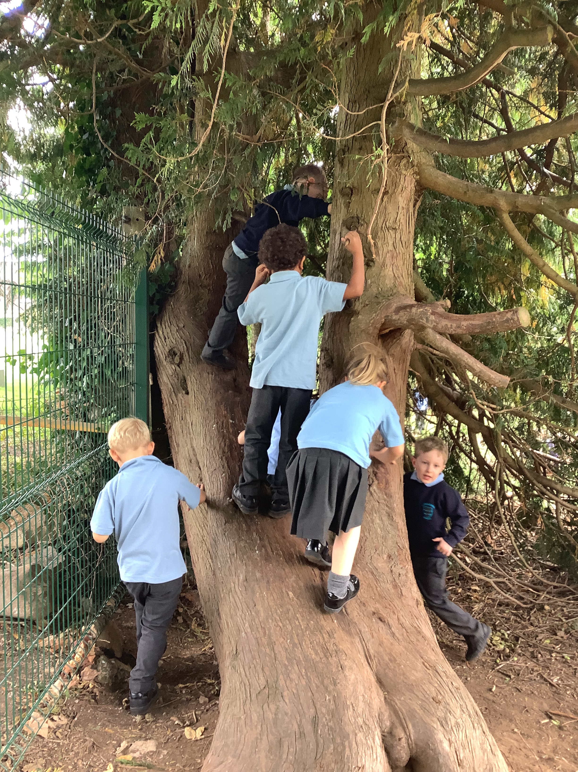
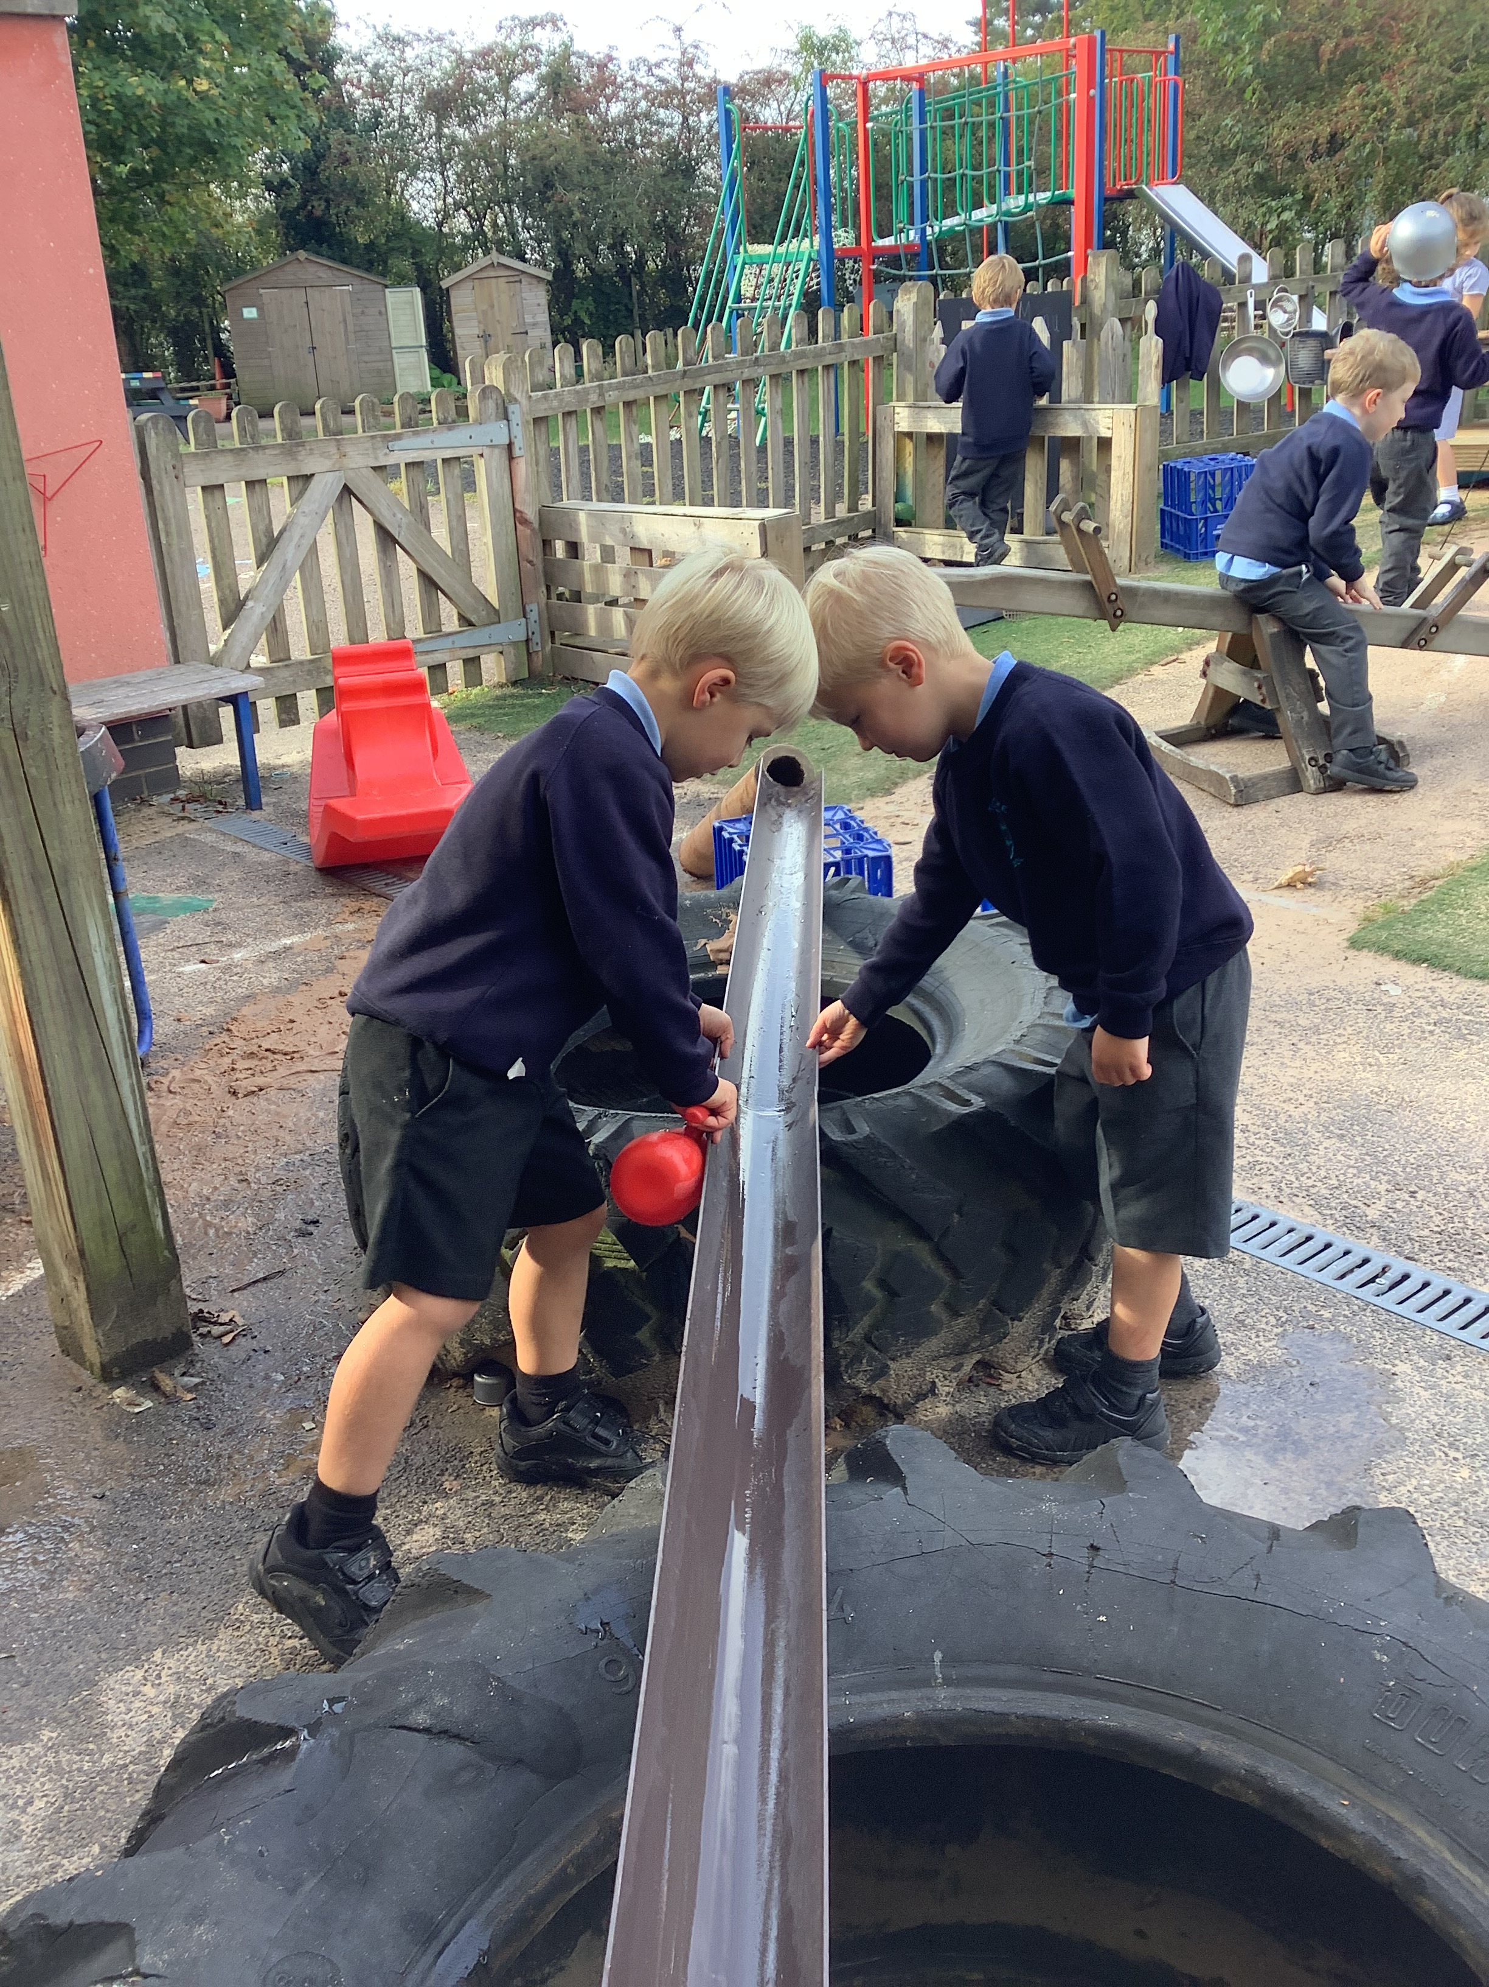
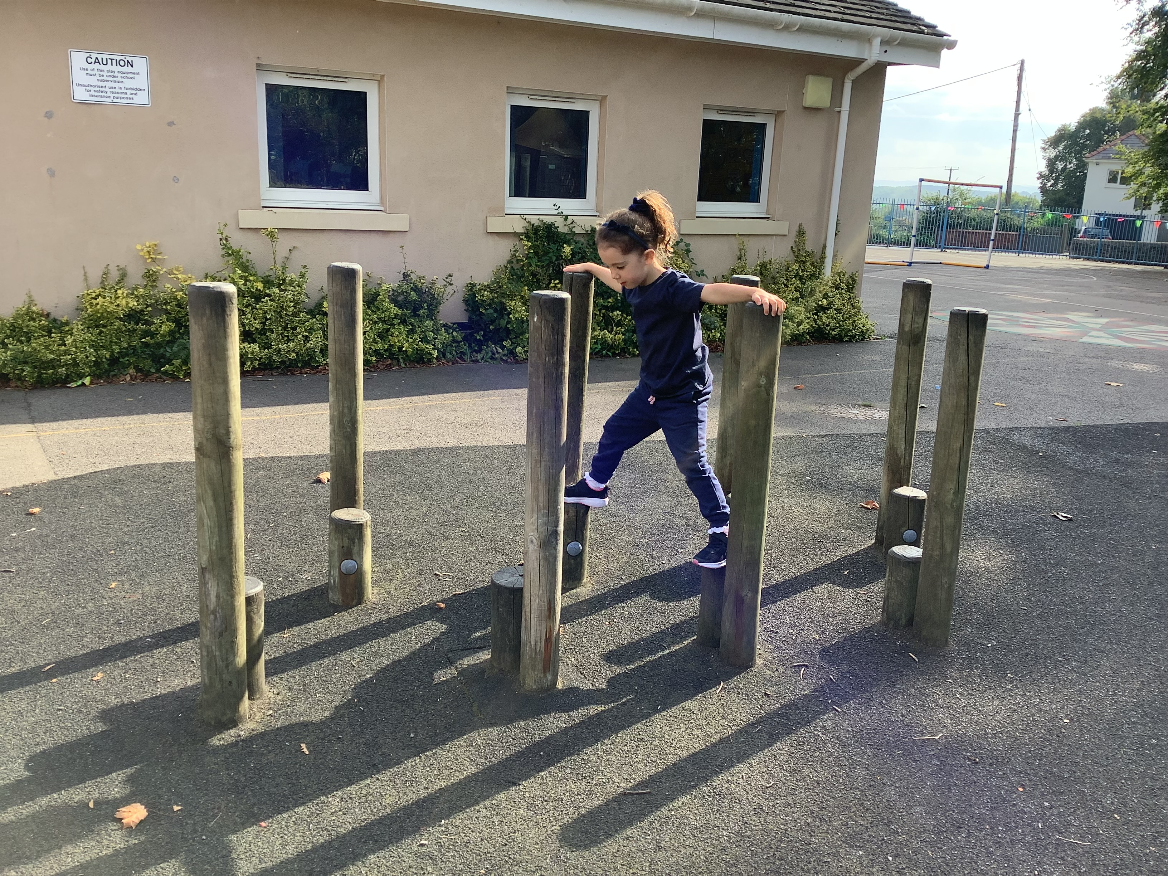
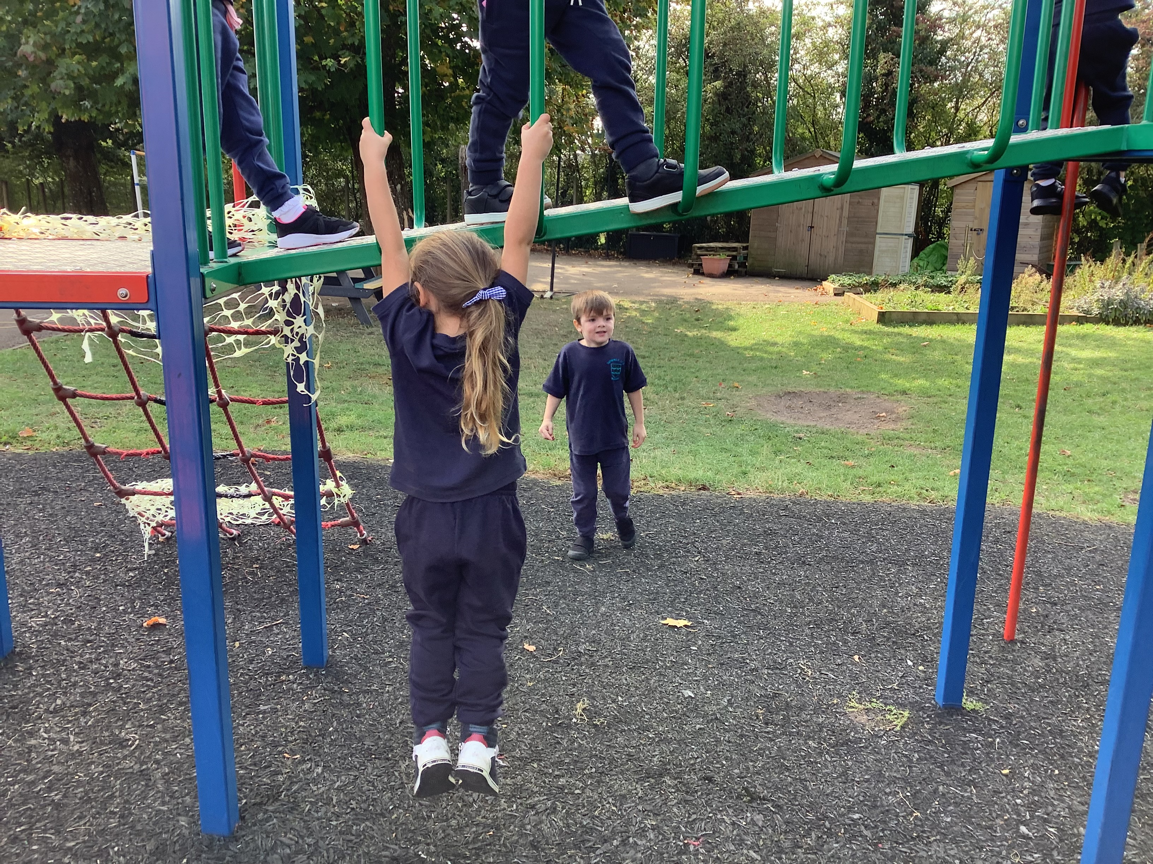

Slide 19
How you can help at home?
Communication and speech.
Share a story every day, repeat the same stories so they become familiar, ask questions and ask what might happen. Expect your child to do what you ask them to do- expect them to follow the instructions you give them- first time!
Independence-
Expect them to dress themselves, including turning clothes the right way round. Expect them to eat with a knife and fork- spoons are for pudding. Expect them to carry their own belongings and get themselves ready.
Mathematics – chanting numbers to 10, counting 1:1 correspondence.
Chant from 1-10, 20 going up stairs, jumping on the trampoline, walking home, Count objects , apples in fruit bowl, pencils in a pot, people at the table, knives, forks etc. ask, how many did we have?
Physical development-
Play at the park on climbing frames. Look at the way your child is holding a pencil, correct them gently, get them a colouring book and pencils/felt tips.
NF

Slide 20
Polite Reminders
~Water bottles
Please do bring a water bottle into school to keep in the classroom. It will be returned at the end of the day to be washed and refilled.
~Health
Please keep us informed of any medical changes that may affect your child in school.
~Labelling
Please label all of your child’s belongings including uniform, coats, water bottles, PE kit etc.
~PE Days
We will be doing PE with the children on a Monday and Thursday so we ask that your child comes dressed in their PE kit to school on PE days.
~Home Time
Should your child’s going home arrangements change, please do let us know either in person that morning or by informing the school office.
LP

Slide 21
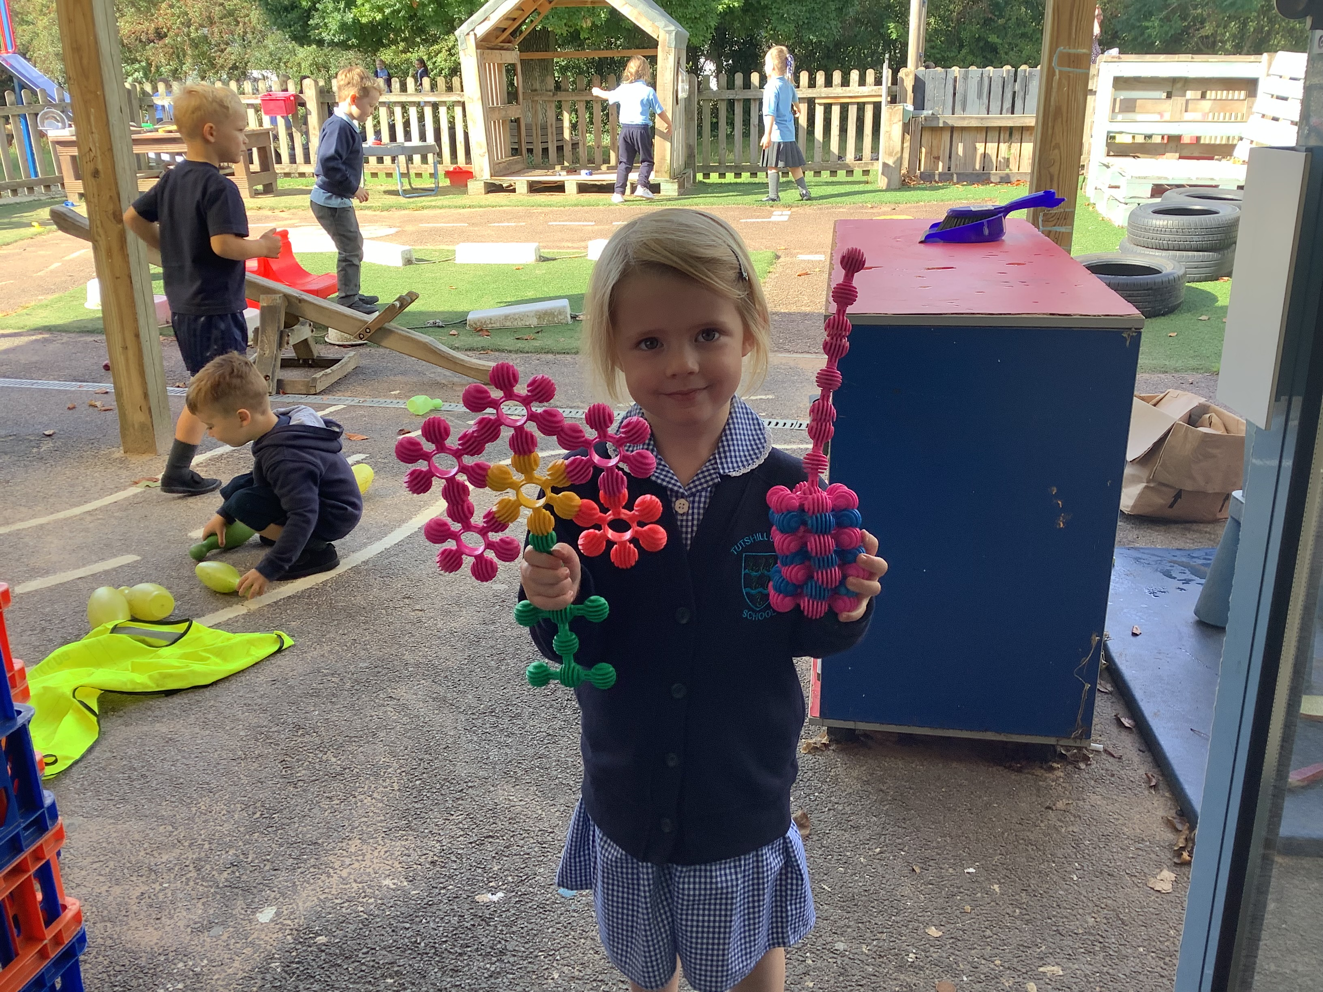
Thank you
If you have any further questions, please do not hesitate in coming to speak to us.
Thank you for coming.

